Slide 1
Auctions (Resource Allocation)
Edited by: Fuad Noman
Inspired from MUA slides by: Bernd Meyer
School of Information Technology, Monash University Malaysia
FIT5226: Multi-Agent Systems and Collective Behaviour
Notes:
In game theory and social choice, auctions and resource allocation are closely related concepts, both revolving around how to distribute scarce resources among competing agents. Here’s an overview of what auctions mean in this context and how they connect to voting and social choices:
Auctions in Resource Allocation
Definition:
Auctions are mechanisms through which goods, services, or resources are allocated among participants who express their preferences through bids. They can be used to allocate resources efficiently in various contexts, such as public goods, spectrum licenses, or even assignments in a project.
Types of Auctions:
English Auction: Bidders publicly bid against one another, with the highest bidder winning.
Dutch Auction: The auctioneer starts with a high price and lowers it until a bidder accepts the current price.
Sealed-Bid Auction: Bidders submit confidential bids without knowing others' offers, and the highest bidder wins.
Vickrey Auction: A sealed-bid auction where the highest bidder wins but pays the price of the second-highest bid.
Objectives:
The primary goal of auctions in resource allocation is to achieve efficient outcomes, meaning resources are distributed to those who value them the most, reflected in their bids.
Connection to Voting and Social Choices
Collective Decision-Making:
Both auctions and voting involve collective decision-making processes where individuals (bidders or voters) express their preferences. The outcome reflects a social choice based on the individual inputs.
Preference Expression:
In voting, individuals express their preferences over options (e.g., candidates or policies), while in auctions, they express their valuations for items or resources. The aggregation of these preferences determines the final allocation in both scenarios.
Social Welfare:
Both frameworks aim to maximize social welfare:
In auctions, this means allocating resources to those who value them the most.
In voting, it often refers to selecting policies or candidates that maximize the overall satisfaction of voters.
Strategic Behavior:
Participants in both auctions and voting may engage in strategic behavior to influence outcomes. For instance:
In auctions, bidders may underbid or overbid based on their knowledge of competitors' valuations.
In voting, voters may vote strategically (e.g., tactical voting) to support candidates who have a better chance of winning, even if they are not their first choice.
Mechanisms and Incentives:
Just as auction mechanisms are designed to incentivize truthful bidding (like the VCG mechanism), voting systems are designed to encourage voters to express their true preferences without strategic manipulation.
Summary
In summary, auctions serve as a method of resource allocation that shares foundational concepts with voting and social choice. Both involve individual preference expression, aim for collective welfare maximization, and are influenced by strategic considerations. By understanding auctions in the context of game theory and social choices, we can better analyze how resources and decisions are allocated in various social and economic systems.

Slide 2
Outlines
Introduction to Auctions.
Key Auction Elements: (Auctioneer, Bidders, and Good).
Types of Value: (Private Value, Common Value, Correlated Value).
Auction Mechanisms: (English Auction, Dutch Auction, First-Price Sealed-Bid, and Vickrey Auction)
Combinatorial Auctions: (Winner Determination and Bidding Languages).
VCG Mechanism: (Incentive Compatible, and Maximizes Social Welfare)
Collusion.
10/14/2024
FIT5226-S2-2024
2/46

Slide 3
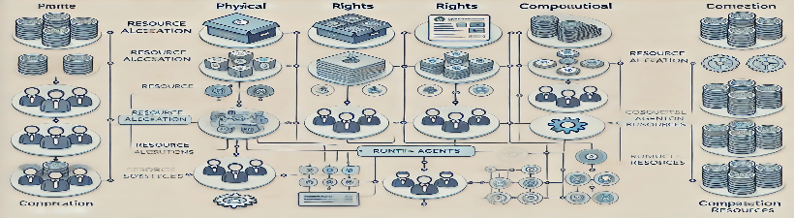
Resource Allocation in Multi-agent Systems
Central Problem: Allocation of scarce resources among multiple agents is a fundamental challenge in multi-agent systems.
Diverse Resources: Resources encompass various forms:
Physical objects (e.g., goods, equipment).
Rights to use assets (e.g., land, licenses).
Computational resources (e.g., processor time, memory).
10/14/2024
FIT5226-S2-2024
3/46
Notes:
This slide highlights the importance of resource allocation as a core issue in multi-agent systems. It emphasizes the wide range of resources that might need to be allocated.
Central Problem:
The core challenge in multi-agent systems revolves around allocating limited resources among multiple agents.
This allocation must be managed efficiently to ensure that the agents achieve their goals with minimal conflicts.
Diverse Forms of Resources:
Resources are not just physical objects but span different categories, each requiring careful allocation:
Physical Objects:
Examples: goods, equipment.
Agents may need these tangible items to perform tasks or achieve objectives.
Rights to Use Assets:
Examples: land, licenses.
Allocation here involves granting access or usage rights to these assets, which may have legal or regulatory implications.
Computational Resources:
Examples: processor time, memory.
Particularly important in systems where agents operate in a digital environment, such as cloud computing or distributed networks.
Key Takeaway:
Balancing resource allocation ensures agents can operate efficiently without depleting or monopolizing resources. This is essential for maintaining system harmony and performance in multi-agent environments.

Slide 4
Supply and Demand
Driving Force: Resource allocation hinges on the balance between supply and demand.
Simple Cases: If a resource is abundant or there's no competition, allocation is straightforward.
Challenge: When demand exceeds supply, a mechanism is needed to determine how to distribute the limited resource fairly and efficiently.
10/14/2024
FIT5226-S2-2024
4/46
Notes:
This slide introduces the economic principles of supply and demand, explaining how they directly influence resource allocation. It sets the context for exploring auctions as a solution to allocation problems when demand outstrips supply.
Driving Force:
The fundamental principle of resource allocation is the relationship between supply (availability of resources) and demand (need for those resources).
Understanding this balance is crucial for effective allocation strategies in multi-agent systems.
Simple Cases:
When resources are abundant, or when there is little to no competition for them, allocation becomes straightforward.
In these scenarios, resources can be distributed without much complexity, as the supply easily meets the demand.
Challenge:
Problems arise when demand exceeds supply. In such cases, there is a need for a mechanism to fairly and efficiently distribute the limited resources.
This could involve:
Prioritization of needs based on criteria such as urgency or importance.
Implementation of algorithms or rules that allow for equitable access among competing agents.
Strategies for negotiation or bidding to help allocate resources effectively.
Key Takeaway:
Achieving a fair and efficient allocation of scarce resources requires careful consideration of supply and demand dynamics. This challenge is central to the functioning of multi-agent systems and can significantly impact overall performance and satisfaction among agents.

Slide 5
Auctions and the Internet
Traditional Rarity: Auctions were historically uncommon.
Internet Revolution: The internet's advent has led to a dramatic surge in auction usage.
Frictionless Commerce: Online platforms facilitate smooth and efficient transactions.
Expanded Scope: Items that were previously unprofitable to auction are now viable.
Prominent Examples: eBay and Adword auctions.
10/14/2024
FIT5226-S2-2024
5/46
Notes:
This slide traces the evolution of auctions, emphasizing the transformative impact of the internet. It highlights how online auctions have made transactions easier and extended the reach of auction-based markets.
Traditional Rarity:
Historically, auctions were not a common method for resource allocation or sales.
Often limited to specialized markets, art, or estate sales.
Internet Revolution:
The emergence of the internet has transformed the auction landscape.
A significant increase in both the number and types of auctions available to consumers.
Frictionless Commerce:
Online auction platforms have minimized barriers to entry.
Transactions can occur quickly and efficiently without the need for physical presence.
Expanded Scope:
Items previously deemed unprofitable or too niche for auctions are now being sold online.
This includes everyday items, collectibles, and even digital goods.
Prominent Examples:
eBay: One of the first online auction platforms that revolutionized consumer-to-consumer sales.
Adword Auctions: Google's auction system for ad placements, demonstrating auction principles in digital advertising.

Slide 6

Defining Auctions
Formal Definition: An auction is a market institution where:
Traders exchange messages containing price information (bids or asks).
Higher bids and lower asks receive priority.
Key Participants:
Auctioneer: The agent selling the good.
Bidders: Agents competing to buy the good.
10/14/2024
FIT5226-S2-2024
6/46
Notes:
This slide provides a precise definition of auctions, clarifying the role of price information and the interaction between auctioneer and bidders.
Formal Definition:
Auction as a Market Institution:
Auctions serve as structured environments where goods or services are exchanged through competitive bidding.
Participants communicate their intentions to buy (bids) or sell (asks) through messages containing price information.
Priority Mechanism:
In an auction, the mechanism prioritizes higher bids and lower asks. This means:
Higher Bids: Bidders offering a higher price for an item will have precedence in purchasing it.
Lower Asks: Sellers offering lower prices are prioritized in selling their goods.
Key Participants:
Auctioneer:
The auctioneer is the individual or entity responsible for facilitating the auction. They oversee the bidding process, ensure fair play, and may set rules for the auction.
Bidders:
Bidders are participants in the auction who compete against each other to acquire goods or services. Their primary goal is to submit the most competitive bid to win the auctioned item.
Summary:
Auctions are critical market institutions that leverage competitive bidding processes to determine the value of goods and services. They rely on effective communication of price information and prioritize bids and asks, creating a dynamic environment for buyers and sellers. The roles of the auctioneer and bidders are essential in ensuring the auction runs smoothly and efficiently.

Slide 7
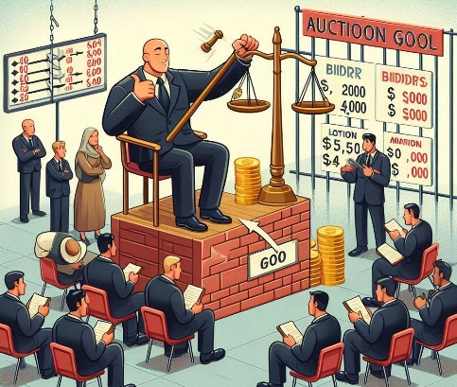
Auction Objectives
Auctioneer's Goal: To allocate the good to a bidder while maximizing the selling price.
Bidders' Goal: To acquire the good at the lowest possible price.
10/14/2024
FIT5226-S2-2024
7/46
Notes:
This slide outlines the conflicting goals of the auctioneer and bidders, setting up the strategic interplay that characterizes auctions.
Auctioneer's Goal:
The primary objective of the auctioneer is to allocate the good to a successful bidder.
A crucial aspect of this goal is to maximize the selling price during the auction process.
Strategies may include setting a reserve price, promoting competitive bidding, and ensuring a fair bidding environment.
Bidders' Goal:
Bidders aim to acquire the good at the lowest possible price.
This goal drives their bidding strategy, often balancing the value of the item against their budget.
Bidders may employ tactics such as incremental bidding, waiting until the last moment to place a bid (sniping), or dropping out when prices exceed their perceived value.
Conflict of Interests:
The auctioneer's goal to maximize revenue often contrasts with bidders' desire to minimize expenditure.
This dynamic creates an environment of competition and strategy, influencing the overall auction outcome.
Impact of Competition:
Increased competition among bidders can lead to higher final selling prices, aligning with the auctioneer's objectives.
Conversely, if bidders perceive that they cannot win at a fair price, they may refrain from participating, affecting the auctioneer’s success.

Slide 8
Types of Value
Private Value: The good's value is subjective and independent of other bidders' valuations.
Example: A rare collectible item holds personal significance for a specific buyer.
Common Value: The good possesses the same inherent value for all bidders, but its exact value may be uncertain.
Example: An oil field's value is the same for all oil companies, but its actual oil reserves are unknown.
Correlated Value: Individual bidders' valuations are interconnected, implying that higher bids from others suggest a higher value for you as well.
Example: The value of a piece of land is influenced by its potential for development, and bids from developers indicate its attractiveness for such projects.
10/14/2024
FIT5226-S2-2024
8/46
Notes:
This slide delves into the different types of value that goods can have in auctions, highlighting how these value types shape bidding strategies and auction outcomes.
Private Value:
The value of the good is subjective to each bidder and independent of others' valuations.
Different bidders may assign different values based on personal preferences, interests, or needs.
Key Point: The good's value doesn't change based on what others think or bid.
Example: A rare collectible item might hold significant emotional value for one person but little or no value for others.
Common Value:
The good holds the same fundamental value for all bidders, but there is uncertainty about the exact value.
Bidders need to estimate the true value, often based on incomplete information.
Key Point: Everyone would agree on the value if they knew all relevant details (like oil reserves or market prices).
Example: An oil field's value depends on how much oil is underground, but since it’s uncertain, bidders must make estimates.
Correlated Value:
The valuations of bidders are interconnected—a higher bid from one bidder can signal greater underlying value to others.
Bidders revise their assessments based on the behavior or interest shown by others.
Key Point: Bidders take cues from competitors' actions, assuming that their bids reflect useful information.
Example: If multiple developers show interest in a piece of land, it suggests that the land has good potential for profitable development.

Slide 9
Winner Determination and Bidding Visibility
Winner Determination: Mechanisms for selecting the winner and determining the price they pay:
First-price auction: The highest bidder wins and pays the amount of their bid.
Second-price auction: The highest bidder wins but only pays the amount of the second-highest bid.
Open Cry vs Sealed-bid: Whether bids are publicly visible or kept confidential:
Open cry: All bidders can observe each other's bids.
Sealed-bid: Bids are submitted secretly, and only the auctioneer knows the bid amounts.
10/14/2024
FIT5226-S2-2024
9/46
Notes:
This slide introduces two key dimensions of auction design: winner determination rules and bid visibility. It explains the differences between first-price and second-price auctions and contrasts open cry with sealed-bid formats.
Winner Determination: Mechanisms used to select the winner and determine how much they pay.
First-price auction:
The highest bidder wins and pays the exact amount of their bid.
Strategy: Bidders may underbid slightly to avoid overpaying.
Second-price auction:
The highest bidder wins but only pays the second-highest bid amount.
Strategy: Encourages bidders to submit their true value, knowing they won’t pay their full bid.
Bidding Visibility: Defines whether bids are publicly visible or kept confidential during the auction.
Open cry auction:
All bids are publicly visible to everyone during the auction.
Example: Traditional auction houses, where participants openly announce their bids.
Effect: Bidders adjust their strategies based on others' bids.
Sealed-bid auction:
Bidders submit their offers secretly, known only to the auctioneer.
Example: Procurement processes or online sealed-bid auctions.
Effect: Encourages independent bidding without external influence.

Slide 10
One-Shot vs Iterated Bids
One-shot: A single round of bidding determines the winner.
Iterated: Multiple bidding rounds occur, with prices either ascending or descending:
Ascending: Bids increase in successive rounds.
Descending: Bids decrease in successive rounds.
Terminating Condition: A rule that specifies when the auction ends (e.g., fixed time, no more bidding activity).
10/14/2024
FIT5226-S2-2024
10/46
Notes:
This slide examines the temporal aspect of auctions, distinguishing between one-shot auctions and those with multiple bidding rounds. It also highlights the importance of a clear terminating condition.
One-Shot Auctions:
Single bidding round determines the winner.
Bidders submit one bid with no chance to revise it.
Example: Sealed-bid auction.
Strategy: Bidders must carefully estimate the value and competition upfront, as no further bids are allowed.
Iterated Auctions:
Multiple rounds of bidding occur, allowing participants to adjust their offers over time.
Can follow two main patterns:
Ascending auction (English auction):
Bids increase in each round until no higher bids are made.
Example: eBay’s bidding system.
Descending auction (Dutch auction):
The auctioneer starts with a high price and reduces it until someone accepts.
Example: Flower auctions in the Netherlands.
Terminating Condition:
Defines when the auction ends, such as:
Fixed time limit: The auction closes at a predetermined time.
Inactivity rule: Ends if no new bids are placed within a specific period.
Ensures a clear and fair conclusion to the auction process.

Slide 11
English Auctions
Popularity: The most widely known auction type, prevalent in various settings.
Procedure:
Open cry format with ascending bids.
Bidders call out increasingly higher bids, or the auctioneer announces prices with bidders signaling agreement.
Reserve Price: The seller can establish a minimum acceptable price.
Auction End: Determined by a fixed time (common in online auctions) or when bidding ceases.
Payment: The "last man standing" (highest bidder) pays their final bid
10/14/2024
FIT5226-S2-2024
11/46
Notes:
This slide provides a detailed description of English auctions, explaining their popularity and the typical steps involved. It mentions the option of a reserve price and different ways auctions can conclude.
Popularity:
English auctions are the most common auction type, used in both traditional and online settings.
Commonly seen in art auctions, estate sales, and online platforms like eBay.
Procedure:
Open cry format:
Bidders announce higher offers verbally or signal through gestures.
Alternatively, the auctioneer calls out prices, and bidders indicate agreement.
Ascending bids: The price increases progressively until no higher bids are placed.
Reserve Price:
Sellers can set a minimum acceptable price (reserve), ensuring the item isn’t sold below a specific value.
If the reserve is not met, the auction may be withdrawn.
Auction End:
Determined by:
Fixed time limit: Common in online auctions, ensuring an auction concludes at a specific time.
No further bidding: Ends when no new bids are placed.
Payment:
The highest bidder at the end (the "last man standing") wins the item.
They pay the final bid amount they offered.

Slide 12
English Auction Strategy
Recommended Strategy:
Incrementally outbid the current highest bid by a small amount until reaching your private valuation.
Withdraw from bidding once the price surpasses your valuation.
10/14/2024
FIT5226-S2-2024
12/46
Notes:
This slide outlines a sensible bidding strategy for English auctions, advising bidders to participate strategically while staying within their budget.
Recommended Strategy:
Incremental Bidding:
Gradually increase your bid by small amounts to remain competitive without overpaying.
Monitor the current highest bid closely and only outbid by a narrow margin to stay in the running.
Private Valuation:
Set a maximum value (private valuation) you are willing to pay based on the item’s worth to you.
Stick to this value to avoid overpaying or falling into the winner’s curse.
When to Withdraw:
Exit the auction once the price exceeds your valuation—continuing beyond this point would result in paying more than the item's perceived value.
Avoid emotional bidding wars by staying disciplined with your budget.

Slide 13
English Auction Classification and Risks
Classification:
First-price: The winner pays their own bid.
Open cry: Bids are publicly visible.
Ascending: Bids increase throughout the auction.
Prevalence: Accounts for approximately 95% of internet auctions.
Typical Uses: Sale of antiques, artwork, and collectibles.
Vulnerabilities:
Winner's curse: The winning bidder may overpay, exceeding the item's true value.
Shills: Fake bidders can artificially inflate prices, manipulating the auction outcome.
10/14/2024
FIT5226-S2-2024
13/46
Notes:
This slide categorizes English auctions based on the previously discussed auction characteristics. It also highlights the prevalence of English auctions on the internet and common applications. Finally, it points out the inherent risks associated with this auction format.
Classification Details:
First-price auction:
The winning bidder pays the exact amount they bid rather than a lower or adjusted amount.
This type can lead to aggressive bidding strategies, especially when participants try to outbid rivals by small margins.
Open cry format:
All bidders are aware of competing bids in real-time, promoting transparency but also intensifying competitive pressure.
This format encourages bidders to act strategically, balancing enthusiasm with caution to avoid overpaying.
Ascending auction:
As the auction progresses, the price gradually increases, typically starting from a reserve or minimum price set by the seller.
This format works best when sellers aim to attract high bids over time and allow buyers to adjust their valuations dynamically.
Prevalence and Common Uses:
Around 95% of online auctions follow this model due to its familiarity and effectiveness in competitive bidding.
Examples:
Antiques, artwork, rare books, vintage cars, and other collectibles where individual valuations vary widely.
The open nature of the auction encourages lively participation, which increases the likelihood of achieving fair market value for items.
Vulnerabilities and Risks:
Winner’s curse:
This phenomenon occurs when the winner overestimates the value of the item and ends up paying more than its true worth.
It is particularly common in auctions where the good's value is uncertain (e.g., art, collectibles) or when competitive bidding becomes emotionally charged.
Solution: Bidders should set a maximum bid limit based on their private valuation and stick to it to avoid regret.
Shill bidding:
Some sellers or accomplices place fake bids to drive up the price artificially.
This practice creates the illusion of higher demand, coercing genuine bidders into raising their bids.
Countermeasures: Online platforms like eBay monitor auctions for suspicious activity and have policies against shill bidding, but bidders should remain cautious of unusual bidding patterns.

Slide 14
Dutch Auctions
Alternative Name: Descending clock auction.
Procedure:
Starts with a high price displayed on a clock.
The auctioneer announces descending prices.
A bidder claims the good by indicating acceptance of the current price.
Ties are resolved by restarting the descent from a slightly higher price.
Payment: The winner pays the price at which they "stop the clock".
10/14/2024
FIT5226-S2-2024
14/46
Notes:
This slide introduces Dutch auctions, describing their alternative name and the step-by-step process involved. It emphasizes the descending price mechanism and how the winner is determined.
Overview and Alternative Name:
Also known as a Descending Clock Auction, this auction style operates in reverse compared to traditional ascending auctions (like English auctions).
It is particularly suited for situations where speed is essential, such as selling perishable goods or quickly clearing inventory.
Procedure:
The auction begins with a high price that gradually decreases over time.
Prices decrease in pre-set increments announced by the auctioneer (or displayed on a clock).
The first bidder to signal their acceptance claims the item at the current price.
This creates a sense of urgency since bidders risk missing out if they wait for the price to drop further.
Handling Ties:
If multiple bidders signal simultaneously, the auction may restart from a slightly higher price to resolve the tie, ensuring fairness.
Payment Mechanism:
The winning bidder pays the price at which they "stop the clock", ensuring transparency and immediate resolution.
Typical Use Cases:
Dutch auctions are widely used in:
Flower markets (e.g., the famous flower auctions in the Netherlands).
Perishable goods where rapid transactions are critical to avoid losses.
Government debt auctions and fisheries where quick sales ensure optimal allocation.
Advantages:
Speed: This auction type reduces waiting time since it only takes one round to conclude.
Encourages Immediate Decisions: Bidders must act quickly to secure the item, creating a high-stakes environment.
Challenges and Risks:
Strategic Waiting vs. Risk: Bidders may wait for the price to drop further, but risk losing the item to another bidder.
Psychological Pressure: The descending nature of the auction can create stress, leading to hasty or regrettable decisions.
Less Participation: Some bidders may feel uncomfortable with the high-pressure format, reducing competition.

Slide 15
Dutch Auction Classification and Applications
Classification:
First-price: The winner pays the price they agreed to.
Open cry: Prices are announced publicly.
Descending: Prices decrease throughout the auction.
Advantages: High volume and swift execution.
Common Uses: Sale of perishable goods (e.g., flowers, fish, tobacco).
10/14/2024
FIT5226-S2-2024
15/46
Notes:
This slide categorizes Dutch auctions according to the established auction characteristics. It mentions their efficiency in handling large quantities of goods quickly and their suitability for selling perishable items.
Auction Classification:
First-price auction:
The winning bidder pays the price they agreed to at the moment they stopped the auction clock.
There are no second chances—bidders must balance waiting for a lower price with the risk of losing the item.
Open cry auction:
Prices are announced publicly in descending increments.
This transparency ensures all participants are aware of the current price at any moment.
Descending auction:
Prices decrease gradually, adding urgency to decisions. The descending format distinguishes it from the more familiar ascending auctions (like English auctions).
Advantages:
High volume transactions:
Dutch auctions are ideal for handling large quantities of goods efficiently. Multiple units can be sold with minimal delays.
Swift execution:
Auctions are resolved quickly because bidders act immediately once the price is right for them.
This speed makes Dutch auctions particularly attractive for time-sensitive scenarios.
Common Applications:
Perishable goods markets:
Widely used in flower markets (e.g., Dutch flower auctions), fish markets, and tobacco sales, where quick decisions are essential to avoid spoilage.
Commodity markets:
Can also be employed in selling other high-volume, time-sensitive commodities or inventory that must be sold quickly.
Government bond auctions:
Some governments use this format to sell debt efficiently by quickly allocating bonds to investors.
Strategic Considerations for Bidders:
Bidders must carefully balance patience with risk. Waiting for a lower price might secure a bargain, but it risks losing the item to another bidder.
This high-pressure environment can create a competitive edge for experienced participants, who know when to act and when to hold off.

Slide 16
First-Price Sealed-Bid (FPSB) Auctions
Procedure:
Bidders submit sealed bids in a single round.
The highest bidder wins and pays their bid amount.
Information Asymmetry: Unlike English auctions, FPSB auctions provide limited information about the good's value, as other bidders' bids remain hidden.
10/14/2024
FIT5226-S2-2024
16/46
Notes:
This slide describes the process of first-price sealed-bid auctions, emphasizing the confidential nature of bids and the one-shot bidding round. It contrasts the information availability in FPSB auctions with that of English auctions.
Auction Procedure:
In a First-Price Sealed-Bid (FPSB) auction, each bidder submits their bid in a sealed format during a single round. This means that all bids are kept confidential until the auction concludes.
After all bids are submitted, the auctioneer opens them simultaneously. The highest bidder is declared the winner and pays the exact amount of their bid.
This process creates a competitive atmosphere where bidders must carefully consider their bidding strategy without knowing others' bids.
Information Asymmetry:
FPSB auctions feature a significant degree of information asymmetry. Unlike in open auctions (e.g., English auctions), where bidders can see each other's bids, FPSB auctions provide limited information about the good's value.
Bidders must estimate the value of the item based on their own information and possibly external factors, leading to uncertainty.
This lack of visibility can complicate bidding strategies, as participants must gauge the competition without direct insight into their valuations.
Bidding Strategy:
Bidders typically employ strategic bidding to maximize their chances of winning while minimizing their payment. This often involves estimating the value of the item and considering how much other bidders might bid.
The optimal strategy might include bidding slightly less than one’s true valuation to avoid the winner's curse, where the winner ends up overpaying relative to the item’s actual value.
Bidders may also take into account the number of competitors and their perceived bidding behavior, adjusting their bids accordingly.
Applications:
FPSB auctions are commonly used in various contexts, including:
Real estate transactions: Buyers submit sealed offers, allowing sellers to choose the best offer without revealing others' bids.
Government contracts: Agencies may use FPSB auctions to award contracts while ensuring bidders cannot adjust their offers based on competitors' actions.
Online auctions: Some online platforms use FPSB formats, where users submit their bids without knowing others’ offers until the auction ends.
Advantages and Disadvantages:
Advantages:
Confidentiality can encourage more honest bidding, as bidders may feel more comfortable submitting bids without peer pressure.
The auction format can simplify the bidding process, avoiding the complexities of real-time bidding wars.
Disadvantages:
The risk of underbidding can result in a situation where the item is sold for less than its market value if participants are overly conservative.
Bidders may experience heightened uncertainty due to limited information, potentially leading to less optimal outcomes.

Slide 17
FPSB Auction Classification and Uses
Classification:
One-shot: A single bidding round decides the winner.
First-price: The winner pays their submitted bid.
Sealed bid: Bids are kept confidential until the auction ends.
Common Applications:
Government sales of treasury bonds.
Property sales (e.g., in Scotland).
10/14/2024
FIT5226-S2-2024
17/46
Notes:
This slide categorizes FPSB auctions based on their characteristics. It also mentions typical use cases, including government bond auctions and certain property markets.
Auction Classification:
One-shot:
This type of auction involves a single round of bidding where bidders submit their bids at once. The process is straightforward, with no subsequent rounds of bidding or negotiations.
The winner is determined solely based on the highest bid submitted in this round.
First-price:
In a first-price auction, the highest bidder wins and pays the exact amount of their bid.
This format creates competitive pressure, as bidders must balance between bidding high enough to win while avoiding overbidding.
Sealed bid:
Bids are submitted in a confidential manner, meaning bidders do not see each other's bids until the auction concludes.
This confidentiality can lead to strategic bidding decisions, as bidders must rely on their assessments and estimates of the item's value without knowing competitors' offers.
Common Applications:
Government Sales of Treasury Bonds:
FPSB auctions are frequently employed by governments to sell treasury bonds. In this context, financial institutions submit sealed bids for the amount and yield they are willing to accept.
This approach allows for a clear and competitive bidding process, ensuring the government secures optimal pricing based on market demand.
Property Sales (e.g., in Scotland):
In Scotland, FPSB auctions are often used for property sales, where prospective buyers submit sealed bids for residential or commercial properties.
This system enables buyers to make offers without revealing their intentions to competitors, fostering a competitive environment that can drive up property values.
Advantages and Disadvantages:
Advantages:
Efficiency: The one-shot nature of FPSB auctions simplifies the bidding process and expedites the sale, making it attractive for time-sensitive transactions.
Reduced Bidder Pressure: Bidders can make their decisions without the stress of competing in real-time, allowing for more thoughtful and strategic bidding.
Disadvantages:
Information Asymmetry: The lack of visibility into other bidders' strategies can lead to uncertainty, making it challenging for bidders to gauge the competitive landscape accurately.
Risk of Low Winning Bids: If bidders undervalue the item, it may be sold for less than its potential market price, impacting the seller's revenue.

Slide 18
Vickrey Auctions
Procedure:
Sealed-bid auction with a single round.
The highest bidder wins but pays the amount of the second-highest bid.
Unique Feature: The payment rule encourages bidders to reveal their true valuations truthfully.
Resistance to Manipulation: Vickrey auctions are less susceptible to strategic bidding manipulations compared to other formats.
10/15/2024
FIT5226-S2-2024
18/46
Notes:
This slide introduces Vickrey auctions, explaining their sealed-bid nature and the distinctive second-price payment rule. It highlights the incentive for truthful bidding and the auction's robustness against strategic behavior.
Auction Procedure:
Sealed-bid Format:
In a Vickrey auction, bidders submit sealed bids in a single round. This means that all bids are kept confidential until the auction concludes.
Bidders do not know the amounts offered by their competitors, which maintains an element of uncertainty and strategy.
Winning and Payment:
The highest bidder wins the auction but pays the amount of the second-highest bid rather than their own. This unique payment structure differentiates Vickrey auctions from traditional sealed-bid or first-price auctions.
For example, if Bidder A bids $100, Bidder B bids $90, and Bidder C bids $80, Bidder A wins but pays $90.
Unique Features:
Truthful Bidding Encouragement:
The payment rule incentivizes bidders to reveal their true valuations of the item. Since winning does not require paying their own bid, bidders are motivated to bid their actual worth of the item rather than strategizing based on what they think others will bid.
This aspect can lead to a more efficient allocation of resources, as the final price reflects the true value of the item based on collective valuations.
Resistance to Manipulation:
Strategic Bidding Manipulation:
Vickrey auctions are less susceptible to strategic bidding manipulations compared to other auction formats, such as first-price sealed-bid or English auctions.
In these other formats, bidders may try to deceive competitors by bidding strategically below their true valuation to win at a lower price. However, in Vickrey auctions, overbidding does not benefit a bidder, as they will ultimately pay the second-highest bid, regardless of their bid amount.
Advantages:
Efficiency and Optimality:
Vickrey auctions often lead to outcomes that maximize overall welfare, as the item goes to the bidder who values it most highly. This can enhance market efficiency.
Simplified Decision-Making:
Bidders do not need to strategize about the actions of others, making the decision-making process more straightforward and focused solely on personal valuation.
Disadvantages:
Risk of Misunderstanding:
New bidders may misunderstand the auction process and payment mechanism, which could deter participation.
Potentially Lower Revenue for Sellers:
Sellers may receive less revenue if bidders lowball their bids, anticipating that they will pay the second-highest bid rather than their own.

Slide 19
Vickrey Auction Classification and Applications
Classification:
One-shot: Single bidding round.
Sealed bid: Confidential bids.
Second-price: Winner pays the second-highest bid.
Historical Uses: Sales of stamps and other collectibles.
10/14/2024
FIT5226-S2-2024
19/46
Notes:
This slide categorizes Vickrey auctions and notes their historical use in specific markets, particularly those involving collectibles.
Classification of Vickrey Auctions:
One-shot Auction:
This format consists of a single bidding round where all participants submit their bids simultaneously. The simplicity of this structure allows for quick resolutions and straightforward outcomes, making it efficient for both bidders and sellers.
Sealed Bid:
In a Vickrey auction, all bids are kept confidential until the auction concludes. This confidentiality ensures that bidders do not have insights into their competitors' strategies or valuations, which can lead to more honest bidding.
Second-price Mechanism:
The defining feature of Vickrey auctions is that the winner pays the amount of the second-highest bid rather than their own. This unique aspect encourages bidders to submit their true valuations, as they will not benefit from underbidding.
Historical Uses:
Sales of Stamps:
Vickrey auctions have been historically used for the sale of rare stamps. In these auctions, bidders are encouraged to reveal their true valuations of collectible items, leading to fair pricing based on actual market demand.
Other Collectibles:
Similar to stamps, Vickrey auctions have also been applied to the sale of various collectibles such as coins, antiques, and art pieces. The second-price bidding structure helps ensure that valuable items are allocated to those who value them the most.
Advantages of Vickrey Auctions:
Truthful Bidding:
The structure inherently encourages truthful bidding because bidders can strategize less about competitors’ potential bids.
Market Efficiency:
The auction tends to allocate goods to the highest valuing bidders, promoting overall market efficiency.
Potential Applications:
Government Procurement:
Vickrey auctions can be utilized for government contracts or procurement processes, where transparency and fair pricing are crucial.
Online Marketplaces:
Platforms such as eBay and others could explore Vickrey auction formats for selling high-value items, as it aligns with their digital environment while encouraging competitive bidding.
Considerations:
Limited Awareness:
Some bidders may be unfamiliar with the mechanics of Vickrey auctions, potentially leading to under-participation or misunderstanding of bidding strategies.
Complexity for Sellers:
Sellers must ensure that they adequately communicate the auction format to maximize participation and revenue.

Slide 20
Why Vickrey Auctions Encourage Truthful Bidding: Overbidding
Scenario: Assume a bidder bids higher than their true valuation (overbidding).
Potential Outcomes:
Winning but overpaying: If the second-highest bid is still below your valuation, you win but pay more than the good is worth to you.
Losing: If the second-highest bid exceeds your bid, you lose regardless of whether you overbid or bid truthfully.
|--------------------|--------------------|---------------------------|
True value $40 2nd Highest: $50 Your bid: $70
10/14/2024
FIT5226-S2-2024
20/46
Notes:
This slide analyzes the consequences of overbidding in a Vickrey auction, demonstrating that it either leads to an unfavorable outcome or has no impact compared to truthful bidding.
Understanding Overbidding:
Definition: Overbidding occurs when a bidder submits a bid that exceeds their true valuation of the item being auctioned. This strategy can be motivated by a desire to secure the item but often leads to undesirable outcomes.
Potential Outcomes of Overbidding:
Winning but Overpaying:
If a bidder overbids and wins, they may find themselves paying a price higher than the value they assign to the good. For example, if a bidder values an item at $100 but bids $120 and wins, they must pay the price of the second-highest bid, which might still be lower than their valuation.
This scenario creates a situation where the bidder ends up with a net loss, as they have overpaid relative to their personal valuation. Such outcomes can lead to bidder regret, reducing the incentive to overbid in future auctions.
Losing the Auction:
If the second-highest bid exceeds the overbid amount, the bidder loses the auction regardless of their overbid. For instance, if the highest bid is $120 and the second-highest bid is $130, the bidder who overbid at $120 loses the item.
This outcome reinforces the futility of overbidding because it does not guarantee winning the auction, and participants realize that truthful bidding is a safer and more rational strategy.
Comparison with Truthful Bidding:
Strategic Incentives:
When bidders are aware that overbidding does not guarantee a win and may lead to unfavorable outcomes, they are more likely to bid according to their true valuation.
Truthful bidding ensures that participants only pay what they believe the item is worth, which increases satisfaction with the auction process and outcomes.
Psychological Factors:
Fear of Regret:
The potential for regret from overpaying or losing due to overbidding encourages bidders to carefully consider their bids. The fear of making a costly mistake can drive participants towards more honest bidding behaviors.
Market Efficiency:
Allocative Efficiency:
By encouraging truthful bidding, Vickrey auctions enhance market efficiency. Items are allocated to those who value them the most, ensuring that resources are distributed optimally.
Conclusion:
Vickrey auctions create a unique bidding environment where overbidding can lead to negative consequences. By understanding these potential outcomes, bidders are incentivized to reveal their true valuations, making Vickrey auctions a robust mechanism for fair and efficient resource allocation.

Slide 21
Why Vickrey Auctions Encourage Truthful Bidding: Underbidding
Scenario: Assume a bidder bids lower than their true valuation (underbidding).
Potential Outcomes:
Losing a potential win: If your true valuation exceeds the second-highest bid, but you underbid (i.e., bid below your true valuation), you miss out on winning.
Winning but with no price benefit: If you win, the price you pay is not influenced by your underbid; you still pay the second-highest bid.
|------------------|---------------------|---------------------------|
Your Bid: $70 2nd Highest: $80 True Value: $100
10/15/2024
FIT5226-S2-2024
21/46
Notes:
This slide examines the implications of underbidding in a Vickrey auction, showing that it either reduces your chances of winning or has no effect on the final price.
Understanding Underbidding:
Definition: Underbidding occurs when a bidder submits a bid that is lower than their true valuation of the item being auctioned. This strategy may stem from caution or an attempt to save costs, but it can lead to significant drawbacks.
Potential Outcomes of Underbidding:
Losing a Potential Win:
If a bidder underbids—meaning they submit a bid lower than their actual valuation—they may miss the opportunity to win the auction. For instance, if a bidder values an item at $150 but submits a bid of only $100, they could lose to another bidder who bids $120.
In this scenario, the underbidding bidder would not only lose the auction but also the chance to acquire the item at a price below their true valuation. This can lead to missed opportunities and potential regret.
Winning but with No Price Benefit:
If a bidder underbids and still wins the auction, they may not experience the expected benefits from underbidding. In a Vickrey auction, the winner pays the amount of the second-highest bid, which is unaffected by the winning bidder's own bid.
For example, if the second-highest bid is $110 and the winning bid is $100 (the underbid), the winner still pays $110, which can be equal to or higher than their underbid amount. This means that underbidding does not provide any financial advantage in terms of the winning price.
Comparison with Truthful Bidding:
Strategic Incentives:
Underbidding can be risky because it may lead to losing an auction or paying an unexpected price. Truthful bidding, on the other hand, allows bidders to secure items at fair prices based on their valuations, minimizing the risk of regret or missed opportunities.
Psychological Factors:
Fear of Overpaying:
While some bidders may fear overpaying and thus choose to underbid, this strategy often backfires. The worry about losing out on a valuable item or paying more than necessary can motivate bidders to stick to their true valuations instead.
Market Efficiency:
Allocative Efficiency:
Vickrey auctions encourage participants to reveal their true valuations, thereby enhancing the overall efficiency of the market. By ensuring that items go to those who value them the most, the auction format promotes optimal resource allocation.
Conclusion:
Underbidding in Vickrey auctions can lead to undesirable outcomes, including the loss of potential wins and missed financial advantages. By understanding these risks, bidders are encouraged to bid truthfully, resulting in fairer auctions and better market outcomes. This dynamic creates a compelling case for the benefits of honest bidding in Vickrey auction formats.

Slide 22
Dominance of Truthful Bidding in Vickrey Auctions
Key Insight: In a Vickrey auction, bidding your true valuation is always the best strategy.
Reasoning:
Overbidding leads to potential losses or no gain compared to truthful bidding.
Underbidding reduces winning chances or has no impact on the price paid.
10/14/2024
FIT5226-S2-2024
22/46
Notes:
This slide summarizes the previous two slides, emphasizing the dominant strategy of truthful bidding in Vickrey auctions. It reinforces the idea that bidders are always best served by aligning their bids with their actual valuations.
Key Insight:
In Vickrey auctions, the strategy of bidding one’s true valuation emerges as the dominant approach. This means that bidders maximize their expected utility by revealing their genuine worth for the item, leading to more favorable outcomes.
Rationale for Truthful Bidding:
Overbidding Risks:
When bidders submit bids that exceed their true valuations (overbidding), they face two primary risks:
Winning and Overpaying: If the bidder wins, they may pay more than the item's actual worth to them, resulting in a loss of consumer surplus.
Loss Due to High Competition: If another bidder places a higher bid, the overbidder will lose the auction, thereby forfeiting the chance to acquire the item entirely. This outcome can be particularly frustrating if the bidder had been willing to pay a lower price that reflected their true valuation.
Underbidding Consequences:
Conversely, underbidding (submitting a bid below one’s true valuation) can lead to negative outcomes as well:
Reduced Chances of Winning: By bidding lower than their actual value, bidders risk losing the auction even when they would have been willing to pay more than the second-highest bid.
No Advantage in Pricing: Even if an underbidder manages to win, they do not gain any financial benefit; they will still pay the second-highest bid. This means their underbid does not translate into any savings, effectively nullifying the strategic advantage they hoped to achieve.
Utility Maximization:
Bidders in Vickrey auctions are motivated by the principle of utility maximization. Bidding truthfully aligns their actions with their true valuations, ensuring they can acquire goods at prices that reflect their perceived worth.
The Vickrey auction structure inherently rewards honesty, as it minimizes the chances of regret and maximizes the likelihood of acquiring valued items without overpaying.
Strategic Equilibrium:
The nature of Vickrey auctions fosters a strategic equilibrium where all rational bidders recognize that truthful bidding is optimal. This convergence on a common strategy enhances the overall efficiency of the auction process, allowing for smoother transactions and fairer distributions of goods.
Conclusion:
The dominance of truthful bidding in Vickrey auctions is a crucial insight for bidders. By understanding the drawbacks of overbidding and underbidding, participants are encouraged to reveal their true valuations, leading to better outcomes for both bidders and sellers. This principle highlights the elegance and effectiveness of the Vickrey auction format in promoting honesty and efficiency in bidding behavior.

Slide 23
Collusion in Auctions
Collusion in auctions refers to an agreement among bidders to coordinate their bids, often resulting in higher prices, reduced competition, and unfair advantages, ultimately undermining the integrity of the auction process.
Susceptibility: All auction types are vulnerable to collusion among bidders.
Collusive Strategies:
Bidders can agree to suppress bids artificially to acquire the good at a lower price and share the profits.
Auctioneer Manipulation:
Auctioneers can employ fake bidders (shills) to drive up prices, potentially leading to the winner's curse.
10/14/2024
FIT5226-S2-2024
23/46
Notes:
This slide addresses the issue of collusion, explaining how bidders or even the auctioneer can manipulate auction outcomes. It underscores the challenges of ensuring fairness and transparency in auction environments.
Susceptibility to Collusion:
Collusion among bidders is a significant concern across all types of auctions. This behavior undermines the integrity of the auction process, leading to inefficiencies and unfair outcomes. Bidders may form agreements, whether explicit or implicit, to manipulate the auction dynamics in their favor.
Collusive Strategies:
Bid Suppression:
Bidders may collaborate to artificially lower bids during the auction. By agreeing in advance on the maximum amount each bidder will offer, they can prevent competitive bidding that would normally drive prices higher. This strategy allows colluding bidders to acquire the item at a price below its market value while sharing any resulting profits.
Price Fixing: They may also coordinate to set a predetermined price for the auction item, thus negating the competitive nature of the auction and creating an unfair advantage over other bidders who are not part of the collusion.
Risks of Collusion:
While collusion may initially seem beneficial for the involved bidders, it carries significant risks:
Legal Consequences: Many jurisdictions consider collusion in auctions to be illegal, and participants may face legal penalties if caught.
Loss of Trust: Collusion can lead to distrust among participants in future auctions, damaging the reputation of the auctioneer and the bidding process overall.
Auctioneer Manipulation:
Shill Bidding:
Auctioneers may employ tactics such as fake bidders (shills) to artificially inflate prices. These shills place bids that create the illusion of competitive interest, driving up the final selling price.
This manipulation can lead to the winner's curse, where the winning bidder ends up overpaying for the item, thinking they are in a competitive bidding scenario when, in fact, the auctioneer has artificially manipulated the bidding landscape.
Consequences for Bidders: Bidders unaware of shill activity may make bids that exceed their true valuations, ultimately resulting in dissatisfaction and financial loss.
Prevention and Regulation:
To mitigate the risks of collusion and manipulation, auction houses can implement measures such as:
Transparency: Providing clear rules and monitoring auction activities to detect unusual bidding patterns.
Reporting Mechanisms: Encouraging participants to report suspicious bidding behaviors can help maintain auction integrity.
Legal Frameworks: Enforcing laws and regulations against collusion can deter such behavior and promote fair competition.
Conclusion:
Collusion poses a significant threat to the efficacy and fairness of auctions. Both bidders and auctioneers can engage in manipulative practices that distort true market values, leading to suboptimal outcomes. Understanding these dynamics is crucial for all participants in the auction process, and robust measures must be in place to ensure fairness and trust in auction settings.

Slide 24
Combinatorial Auctions
Purpose: To auction multiple goods simultaneously as bundles.
Bidding Flexibility: Bidders can bid on any combination of items.
Example Bid: "I bid $100 for the TV, VCR, and couch."
10/14/2024
FIT5226-S2-2024
24/46
Notes:
This slide introduces combinatorial auctions, highlighting their ability to handle auctions for sets of goods rather than individual items. It illustrates this with a practical example of a bid on a bundle of items.
Purpose of Combinatorial Auctions:
Combinatorial auctions are designed to allow bidders to compete for multiple goods simultaneously, enabling the sale of goods as bundles rather than individual items. This approach helps to maximize the total value obtained from the auction by considering the synergies between items that may be more valuable together than separately.
Bidding Flexibility:
In combinatorial auctions, bidders have the flexibility to place bids on any combination of items. This allows participants to express their preferences and valuations more accurately. For instance, a bidder might perceive greater value in acquiring a set of items than in obtaining them individually, leading to more competitive bidding and potentially higher revenue for the seller.
Strategic Bidding: Bidders can craft strategic bids that reflect their unique valuation of different combinations. This strategy can lead to more efficient allocations, as it allows bidders to indicate how much they are willing to pay for specific bundles rather than being limited to individual item bids.
Example of a Bid:
An example bid might be stated as follows: “I bid $100 for the TV, VCR, and couch.” This bid indicates the bidder's willingness to pay a specific amount for a specific combination of goods, capturing the additional value perceived in acquiring all three items together.
Complex Bidding Scenarios: In practice, bids can become quite complex, with bidders potentially offering multiple combinations. For example, one bidder might offer $100 for a bundle of three items while another bidder might offer $60 for just one of those items. This complexity can create challenges in determining the winning bids and the overall allocation of goods.
Challenges of Combinatorial Auctions:
Winner Determination: The process of determining the winning bids in combinatorial auctions can be computationally intensive. Auctioneers need to analyze various combinations to maximize total revenue, which can lead to challenges in implementation.
Information Asymmetry: Bidders may have differing levels of information about the value of items, leading to strategic bidding behavior and potential misunderstandings about the true worth of the bundles.
Potential for Collusion: As with other auction types, combinatorial auctions can also be susceptible to collusion, where bidders coordinate to suppress competition and manipulate the bidding process.
Applications of Combinatorial Auctions:
Spectrum Auctions: One common application of combinatorial auctions is in the allocation of wireless communication spectrum licenses, where bidders might want to acquire multiple frequencies to create a comprehensive service offering.
Resource Allocation: Combinatorial auctions can also be used for resource allocation in various contexts, such as assigning multiple contracts or services to contractors in a construction project.
Conclusion:
Combinatorial auctions represent a sophisticated approach to resource allocation, allowing for greater flexibility and efficiency in bidding. By enabling bidders to express their valuations for combinations of goods, these auctions can lead to more optimal outcomes. However, the complexity of determining winners and managing the auction process presents significant challenges that must be addressed for successful implementation.

Slide 25
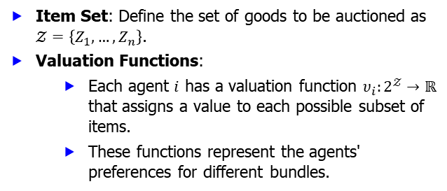
Set of Items and Valuation Functions
Item Set: Define the set of goods to be auctioned as $𝒵=\left\{Z_{1},…, Z_{n}\right\}$.
Valuation Functions:
Each agent $i$ has a valuation function $υ_{i}:2^{𝒵}→ℝ$ that assigns a value to each possible subset of items.
These functions represent the agents' preferences for different bundles.
10/14/2024
FIT5226-S2-2024
25/46
Notes:
This slide introduces the formal notation for the set of items being auctioned and the concept of valuation functions that capture bidders' preferences for various combinations of goods.
Item Set:
The item set in a combinatorial auction is defined as $𝒵= \left\{Z_{1}, Z_{2}, …, Z_{n}\right\}$, where each $Z_{i}$​ represents an individual item up for auction.
This set can include a wide range of goods, such as physical products (e.g., electronics, furniture), digital assets (e.g., software licenses, domain names), or services (e.g., maintenance contracts).
Valuation Functions:
Each agent $i$ involved in the auction has a valuation function denoted $υ_{i}:2^{𝒵}→ℝ$. This function assigns a real number value to each possible subset of items in the auction, which reflects the agent’s perceived worth of that particular bundle.
The notation $2^{𝒵}$ indicates the power set of $𝒵$, representing all possible combinations of items, including individual items and the empty set.
Representation of Preferences:
The valuation functions are crucial for understanding the agents' preferences regarding different bundles of items. For example, if an agent values a bundle of items ${\{Z}_{1}, Z_{2}\}$ at $200, but values ${\{Z}_{1}\}$ at $100 and $\left\{Z_{2}\right\}$ at $80, this indicates a synergy in the combined value of those two items together.
These preferences enable bidders to express how much they are willing to pay for specific combinations, influencing their bidding strategies during the auction.
Implications for Bidding:
The structure of the valuation functions directly impacts how agents will formulate their bids. Agents may choose to bid higher on bundles that align with their valuation functions, ensuring they maximize their utility.
Utility Maximization: In a combinatorial auction, agents aim to maximize their utility, which is the difference between the value they assign to the bundle (as indicated by their valuation function) and the price they ultimately pay.
Challenges in Valuation:
Information Asymmetry: Agents may have different levels of knowledge about the true value of the items or about the valuations of other bidders, leading to strategic behaviors such as bidding conservatively or aggressively.
Complex Valuation Functions: Agents may have complex or nonlinear valuation functions that could complicate the auction's outcome. Understanding these complexities is critical for auctioneers to structure the auction effectively.
Conclusion:
Defining the item set and understanding the associated valuation functions are fundamental components of combinatorial auctions. These elements help capture the nuances of bidder preferences and facilitate more efficient and strategic bidding processes. By recognizing how agents value different combinations of items, auctioneers can design mechanisms that enhance competition and optimize revenue.

Slide 26
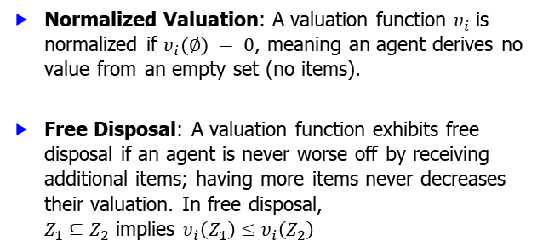
Normalized Valuation and Free Disposal
Normalized Valuation: A valuation function $υ_{i}$ is normalized if $υ_{i}(∅) = 0$, meaning an agent derives no value from an empty set (no items).
Free Disposal: A valuation function exhibits free disposal if an agent is never worse off by receiving additional items; having more items never decreases their valuation. In free disposal, $Z_{1}⊆Z_{2}$ implies $υ_{i}\left(Z_{1}\right)≤υ_{i}\left(Z_{2}\right)$
10/14/2024
FIT5226-S2-2024
26/46
Notes:
This slide delves into two important properties of valuation functions: normalization and free disposal. Normalization ensures that an empty allocation has no value, while free disposal reflects the intuitive notion that more items are generally preferred or at least not detrimental.
Normalized Valuation:
A normalized valuation function $υ_{i}$​ is one that satisfies the condition $υ_{i}(∅)=0$. This implies that an agent does not assign any value to the absence of items.
Importance: This condition ensures that the valuation system is grounded, meaning that all value assessments are relative to the existence of items. It helps in establishing a baseline for the agent’s preferences and prevents irrational valuations where an agent might derive value from having nothing.
Implications of Normalized Valuation:
Clarity in Bidding: By ensuring that an empty set is valued at zero, agents can more clearly evaluate the worth of various bundles. This provides a more structured approach to how they formulate their bids based on the presence of items.
Consistency in Valuations: Normalized valuations contribute to consistency across different agents’ evaluations, as they all recognize that value derives from tangible items rather than an empty set.
Free Disposal:
A valuation function is said to exhibit free disposal if receiving additional items does not negatively impact an agent's valuation. This means that an agent is never worse off for receiving more items.
Mathematically, free disposal is represented as: if $Z_{1}⊆Z_{2}$ then $υ_{i}\left(Z_{1}\right)≤υ_{i}\left(Z_{2}\right)$. This means the value assigned to a smaller subset $Z_{1}$​ is always less than or equal to the value assigned to a larger subset $Z_{2}$​.
Implications of Free Disposal:
Encouragement of Bidding: The concept of free disposal encourages agents to bid for additional items without the fear of diminishing returns. They can bid on bundles without worrying that adding more items will reduce the total value they assign.
Simplifies Auction Dynamics: Free disposal simplifies the decision-making process for agents, as they can be assured that acquiring more items will not result in a decrease in their overall valuation.
Practical Applications: This concept is particularly relevant in auctions where items are often complementary, meaning that the total value of a combination of items is greater than the sum of their individual values.
Challenges and Considerations:
Strategic Bidding: While free disposal simplifies valuations, it also introduces strategic considerations. Agents may attempt to manipulate their bids based on the understanding that more items will always yield a higher or equal valuation.
Diversity in Preferences: Different agents may have varying preferences for bundles of items, which can complicate the dynamics of bidding, even under free disposal.
Conclusion:
Understanding normalized valuation and the principle of free disposal is crucial for analyzing bidder behavior in combinatorial auctions. These concepts help establish a framework for valuing items consistently and encourage more effective and strategic bidding, leading to potentially better outcomes for both bidders and auctioneers.

Slide 27
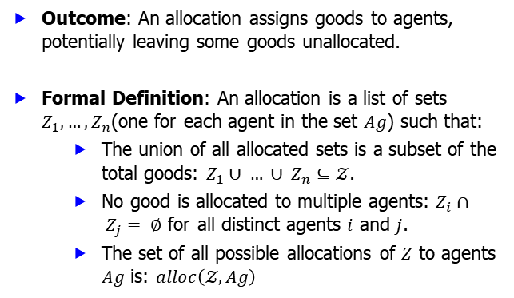
Allocation of Goods
Outcome: An allocation assigns goods to agents, potentially leaving some goods unallocated.
Formal Definition: An allocation is a list of sets $Z_{1}, …, Z_{n}$(one for each agent in the set $Ag$) such that:
The union of all allocated sets is a subset of the total goods: $Z_{1}∪ … ∪ Z_{n}⊆𝒵$.
No good is allocated to multiple agents: $Z_{i}∩ Z_{j}= ∅$ for all distinct agents $i$ and $j$.
The set of all possible allocations of $Z$ to agents $Ag$ is: $alloc\left(𝒵, Ag\right)$
10/14/2024
FIT5226-S2-2024
27/46
Notes:
This slide formally defines an allocation in a combinatorial auction, ensuring that goods are distributed without overlaps and that not all goods are required to be allocated.
Definition of Allocation:
An allocation refers to the process of assigning goods to agents in an auction or resource distribution scenario. It may result in some goods remaining unallocated, depending on the bids and preferences of the agents involved.
Formal Definition:
An allocation is mathematically represented as a list of sets $Z_{1}, …, Z_{n}$​, where each set corresponds to the goods assigned to a specific agent in the set $Ag$.
Conditions of Allocation:
Subset Condition: The union of all allocated sets must be a subset of the total goods available, denoted as: $Z_{1}∪ … ∪ Z_{n}⊆𝒵$. This ensures that no goods outside the available set are assigned to agents.
Disjointness Condition: No good can be allocated to more than one agent, which can be mathematically expressed as: $Z_{i}∩ Z_{j}= ∅$ for all distinct agents $i$ and $j$. This guarantees that each good is uniquely assigned, preventing conflicts and overlap in allocations.
Total Allocation Set:
The set of all possible allocations of goods $Z$ to agents $Ag$ is denoted as: $alloc\left(𝒵, Ag\right)$ This set includes every conceivable distribution of the available goods among the agents while adhering to the conditions outlined above.
Implications of Allocation:
Efficiency: The goal of allocation often revolves around achieving efficiency—maximizing the total value derived from the assigned goods while ensuring that the allocation process is fair and transparent.
Utility Maximization: Agents will typically aim to secure allocations that maximize their own utility or value derived from the goods they receive, which may involve strategic bidding in auctions.
Unallocated Goods: It is essential to consider the implications of unallocated goods, as they represent potential lost value. Understanding why certain goods remain unallocated (e.g., lack of interest, insufficient bids) can provide insights into the auction’s dynamics.
Challenges in Allocation:
Valuation Discrepancies: Different agents may have varying valuations for the same goods, complicating the allocation process and making it challenging to reach a consensus.
Strategic Behavior: Agents may act strategically to influence allocations, such as underbidding or overbidding to secure goods at favorable prices.
Complexity of Combinatorial Auctions: In scenarios involving multiple goods, the complexity of determining optimal allocations increases significantly, necessitating advanced algorithms and approaches to find efficient solutions.
Conclusion:
The allocation of goods is a fundamental aspect of auction theory and resource distribution, requiring careful consideration of the rules and conditions governing how goods are assigned. Understanding the mathematical representation and implications of allocations helps to facilitate effective auction design and ensures fair outcomes for all participants.

Slide 28
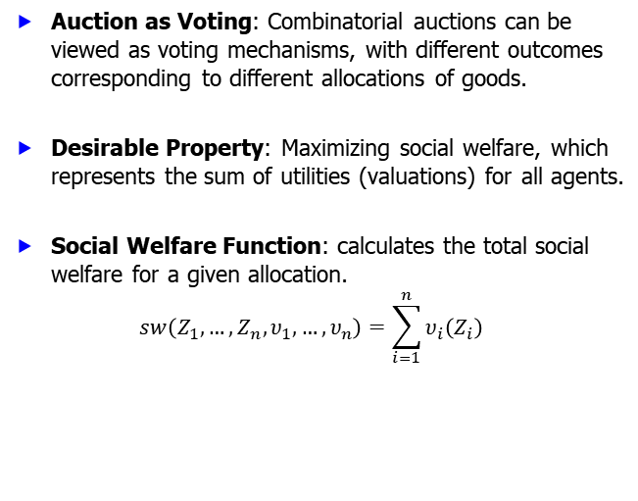
Social Welfare Maximization
Auction as Voting: Combinatorial auctions can be viewed as voting mechanisms, with different outcomes corresponding to different allocations of goods.
Desirable Property: Maximizing social welfare, which represents the sum of utilities (valuations) for all agents.
Social Welfare Function: calculates the total social welfare for a given allocation.
$$sw\left(Z_{1}, …, Z_{n},υ_{1},…,υ_{n}\right)=\sum_{i=1}^{n}{υ_{i}\left(Z_{i}\right)}$$
allocations
valuations
10/14/2024
FIT5226-S2-2024
28/46
Notes:
This slide connects combinatorial auctions to voting systems and introduces the concept of social welfare as a desirable objective. It defines the social welfare function, which quantifies the overall benefit derived from an allocation.
Concept of Social Welfare:
Social Welfare refers to the overall satisfaction or utility derived from the allocation of resources among individuals (agents) in an auction or economic environment. It is a key objective in designing auction mechanisms and is critical for achieving efficient outcomes.
Auction as Voting:
Analogy to Voting: Combinatorial auctions can be conceptualized as voting processes where bidders express their preferences over combinations of goods. Each bid can be viewed as a vote for a particular allocation, leading to diverse outcomes based on collective preferences.
Outcome Diversity: Different combinations of goods allocated to agents correspond to various outcomes, reflecting the preferences and valuations of the participants. Just like in voting, where different candidates may win based on the collective choice, different allocations may yield varying levels of social welfare.
Maximizing Social Welfare:
The goal of social welfare maximization is to find an allocation that maximizes the total utility for all agents involved. This approach emphasizes the importance of considering the collective benefit rather than focusing solely on individual outcomes.
Social Welfare Function:
The social welfare function quantifies the total social welfare for a given allocation of goods to agents, expressed mathematically as:
$$sw\left(Z_{1}, …, Z_{n},υ_{1},…,υ_{n}\right)=\sum_{i=1}^{n}{υ_{i}\left(Z_{i}\right)}$$
Components:
$Z_{i}$​ denotes the set of goods allocated to agent iii.
$υ_{i}$ represents the valuation function of agent iii, which assigns a value to the goods in $Z_{i}$​.
The function sums the valuations of all agents, capturing the total value derived from the allocation.
Importance of Social Welfare Maximization:
Efficiency: Achieving maximum social welfare is often associated with Pareto efficiency, where no individual can be made better off without making someone else worse off.
Fairness: A focus on social welfare encourages fairness in resource allocation, ensuring that agents receive goods in a manner that reflects their valuations and preferences.
Incentives: Maximizing social welfare can help design auction mechanisms that incentivize truthful bidding and participation, leading to better market outcomes.
Challenges in Maximizing Social Welfare:
Complex Valuation Functions: Agents may have complex and heterogeneous valuation functions, making it difficult to aggregate preferences accurately.
Combinatorial Complexity: In combinatorial auctions, the number of possible allocations grows exponentially with the number of goods, complicating the process of identifying the allocation that maximizes social welfare.
Strategic Behavior: Agents may engage in strategic bidding, attempting to manipulate outcomes for personal gain, which can undermine the social welfare objective.
Conclusion:
Social welfare maximization is a fundamental principle in auction design and economic theory, emphasizing the importance of considering collective outcomes in resource allocation. By understanding and applying social welfare functions, auction designers can create mechanisms that lead to efficient, fair, and desirable outcomes for all participants.

Slide 29
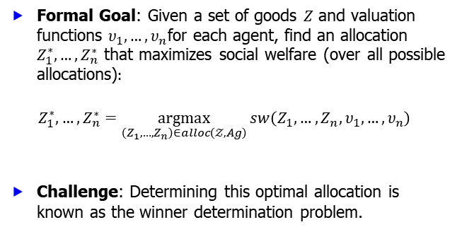
Winner Determination Problem
Formal Goal: Given a set of goods $Z$ and valuation functions $υ_{1}, …, υ_{n}$for each agent, find an allocation $Z_{1}^{∗}, …, Z_{n}^{∗}$ that maximizes social welfare (over all possible allocations)$:$
$$Z_{1}^{∗}, …, Z_{n}^{∗}=\underset{\left(Z_{1}, …, Z_{n}\right)∈alloc\left(𝒵, Ag\right)}{argmax}{sw\left(Z_{1}, …, Z_{n},υ_{1},…,υ_{n}\right)}$$
Challenge: Determining this optimal allocation is known as the winner determination problem.
10/14/2024
FIT5226-S2-2024
29/46
Notes:
This slide explicitly states the goal of winner determination in combinatorial auctions, which is to find the allocation that yields the highest social welfare. It acknowledges the inherent complexity of this problem.
Formal Definition:
The Winner Determination Problem (WDP) seeks to identify the optimal allocation of goods to agents in a manner that maximizes social welfare. Formally, given:
A set of goods $Z$.
Valuation functions $υ_{1},…,υ_{n}$​ for each agent, which assign a value to each possible bundle of items,
The goal is to find the allocation $Z_{1}^{∗}, …, Z_{n}^{∗}$ such that: $Z_{1}^{∗}, …, Z_{n}^{∗}=\underset{\left(Z_{1}, …, Z_{n}\right)∈alloc\left(𝒵, Ag\right)}{argmax}{sw\left(Z_{1}, …, Z_{n},υ_{1},…,υ_{n}\right)}$ where $alloc\left(𝒵, Ag\right)$ represents all possible allocations of the goods to the agents and $sw$ is the social welfare function.
Social Welfare Maximization:
The social welfare function calculates the total utility or satisfaction derived from an allocation: $sw\left(Z_{1}, …, Z_{n},υ_{1},…,υ_{n}\right)=\sum_{i=1}^{n}{υ_{i}\left(Z_{i}\right)}$
This function reflects the collective benefit of all agents based on their valuations for the allocated goods.
Challenges in the WDP:
Computational Complexity: The WDP is generally NP-hard, particularly in combinatorial auctions where multiple items can be allocated in various combinations. This complexity arises from the exponential number of possible allocations that need to be evaluated.
Valuation Dynamics: Each agent's valuation can change based on the combination of items they receive, complicating the determination of optimal allocations.
Strategic Bidding: Bidders may not reveal their true valuations, leading to potential misallocation of goods if the auctioneer does not account for this strategy.
Solution Approaches:
Exact Algorithms: These include methods like dynamic programming or branch-and-bound, but they may be computationally infeasible for large instances.
Approximation Algorithms: These provide a solution close to the optimal allocation in polynomial time, which is often more practical in real-world scenarios.
Heuristic Methods: Techniques such as greedy algorithms or genetic algorithms can be applied to find satisfactory allocations without guaranteeing optimality.
Applications:
The winner determination problem is crucial in various domains, including:
Combinatorial Auctions: Where multiple items are sold together, requiring careful valuation assessments.
Resource Allocation: In cloud computing or telecommunications, where bandwidth or server time may be auctioned off.
Public Procurement: Determining the best bids for government contracts, ensuring taxpayer money is utilized effectively.
Conclusion:
The WDP plays a vital role in ensuring fairness and efficiency in resource allocation within auctions. Understanding its complexities and applying suitable solution strategies is essential for maximizing social welfare in various contexts.

Slide 30
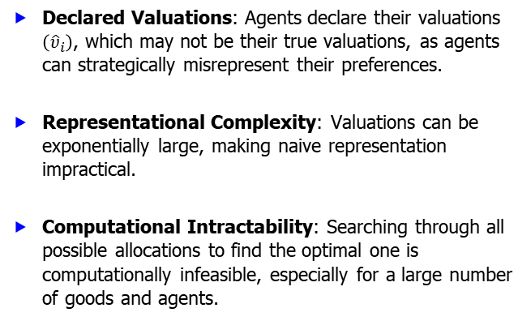
Challenges of Winner Determination
Declared Valuations: Agents declare their valuations $\left({\hat{υ}}_{i}\right)$, which may not be their true valuations, as agents can strategically misrepresent their preferences.
Representational Complexity: Valuations can be exponentially large, making naive representation impractical.
Computational Intractability: Searching through all possible allocations to find the optimal one is computationally infeasible, especially for a large number of goods and agents.
10/14/2024
FIT5226-S2-2024
30/46
Notes:
This slide outlines the difficulties associated with finding the optimal allocation. It points out the potential for agents to lie about their valuations, the exponential size of the valuation space, and the computational burden of exhaustive search.
Declared Valuations:
Strategic Misrepresentation: In many auction formats, agents declare their valuations ${\hat{υ}}_{i}$ for various bundles of goods. However, these declared valuations may not reflect their true valuations due to:
Incentives to Manipulate: Agents may understate or overstate their valuations to gain a competitive edge or secure a better deal, leading to:
Overbidding: Bidding higher than their actual value, risking the winner’s curse.
Underbidding: Bidding lower than their value, which may result in losing valuable items.
Impact on Allocations: Misrepresentation can lead to suboptimal allocations that do not maximize overall social welfare, as decisions are based on distorted information.
Representational Complexity:
Exponential Growth: The number of potential combinations of goods increases exponentially with the number of items and agents:
Each agent can have a unique valuation for every possible subset of goods.
If there are $n$ items, the number of subsets is $2^{n}$. As such, representing valuations for every possible combination can be impractical.
Dimensionality Challenges: As the number of items grows, storing and processing valuation functions becomes increasingly difficult, potentially leading to:
Data Management Issues: Difficulties in maintaining and accessing large datasets efficiently.
Modeling Limitations: Challenges in accurately modeling preferences and valuations for all possible combinations.
Computational Intractability:
Complexity of Searching Allocations: Finding the optimal allocation involves evaluating all possible distributions of goods to agents, which is a combinatorial problem:
NP-Hardness: The problem is classified as NP-hard, meaning no known polynomial-time algorithm can solve it for large instances.
Brute Force Limitations: A brute force approach would require evaluating $n!$possible allocations for $n$ agents, leading to an unmanageable computational load.
Scalability Issues: As the number of agents and goods increases, the time and resources required to determine the optimal allocation become prohibitively high:
Practical Constraints: Real-world auctions often involve many items and participants, making exact solutions infeasible in practice.
Need for Efficient Algorithms: The challenges emphasize the necessity for:
Approximation Algorithms: Methods that can find near-optimal solutions within a reasonable time frame.
Heuristic Approaches: Algorithms that use rules of thumb to generate satisfactory solutions without guaranteeing optimality.
Summary:
The challenges of winner determination highlight the complexities involved in auction mechanisms. Understanding these issues is crucial for developing strategies that enhance auction efficiency and fairness. Addressing these challenges through innovative algorithms and techniques can lead to improved resource allocation in various sectors, including public procurement, combinatorial auctions, and digital marketplaces.

Slide 31
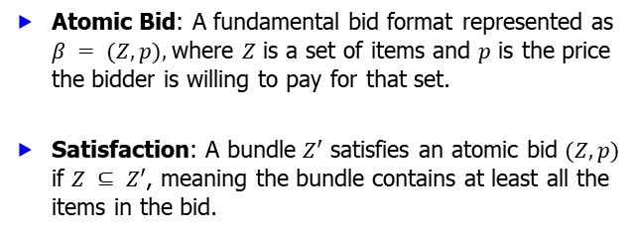
Bidding Languages: Atomic Bids
Atomic Bid: A fundamental bid format represented as $β = (Z, p),$where $Z$ is a set of items and $p$ is the price the bidder is willing to pay for that set.
Satisfaction: A bundle $Z′$ satisfies an atomic bid $(Z, p)$ if $Z ⊆ Z′$, meaning the bundle contains at least all the items in the bid.
10/14/2024
FIT5226-S2-2024
31/46
Notes:
This slide introduces atomic bids as the building blocks for more complex bidding languages. It defines atomic bids and explains the condition for a bundle to satisfy a bid.
Definition of Atomic Bid:
An atomic bid is a basic unit of bidding in combinatorial auctions that encapsulates a specific offer for a defined set of goods.
It is represented as: $β = (Z, p),$where:
$Z$ is a set of items that the bidder is interested in acquiring.
$p$ is the price the bidder is willing to pay for the entire set $Z$.
Key Characteristics:
Specificity: Each atomic bid focuses on a particular combination of items, allowing bidders to express their preferences clearly and precisely.
Price Sensitivity: The price $p$ reflects the bidder's valuation of the bundle $Z$, which is critical for determining the competitiveness of the bid in the auction.
Satisfaction of Atomic Bids:
A bundle $Z′$is said to satisfy an atomic bid $(Z, p)$if: $Z ⊆ Z′$, This means that the bundle $Z′$must contain all items specified in the original bid $Z$, fulfilling the bid's requirements.
Implications:
Inclusion Requirement: For a bidder to win with an atomic bid, the winning bundle must at least contain the items they originally expressed interest in.
Winning Condition: If the auctioneer allocates a bundle $Z′$to a bidder whose atomic bid is $(Z, p)$, the auctioneer must ensure that the price of the bundle $Z′$does not exceed the bidder's stated price $p$.
Practical Application:
Atomic bids allow for flexibility in bidding, enabling participants to compete for specific combinations of goods, which is especially useful in complex auctions involving diverse items.
They simplify the decision-making process for both bidders and auctioneers by clearly delineating what is being offered and the associated price.
Use Cases: Common in scenarios where items have interdependencies or synergies (e.g., selling property lots, bundles of goods, or services).
Advantages:
Enhanced Bidding Precision: Bidders can articulate their desires for particular combinations, rather than being constrained to bidding for items individually or in non-specific bundles.
Market Efficiency: By allowing bidders to express their valuations for specific combinations, atomic bids contribute to a more efficient allocation of resources in combinatorial auctions.
Conclusion:
Atomic bids serve as a foundational element in combinatorial auction formats, providing a structured way for bidders to participate while maximizing their chances of obtaining desired items at acceptable prices. Understanding this bidding language is essential for both bidders and auction designers in fostering effective auction dynamics.

Slide 32
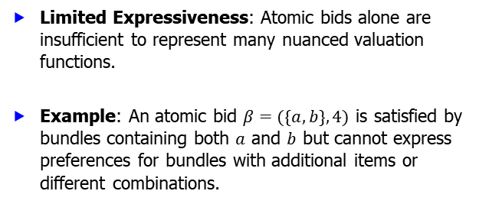
Bidding Languages: Atomic Bid Limitations
Limited Expressiveness: Atomic bids alone are insufficient to represent many nuanced valuation functions.
Example: An atomic bid $β=(\{a, b\}, 4)$ is satisfied by bundles containing both $a$ and $b$ but cannot express preferences for bundles with additional items or different combinations.
10/14/2024
FIT5226-S2-2024
32/46
Notes:
This slide points out the limitations of using only atomic bids, demonstrating that they lack the flexibility to express more intricate preferences over bundles.
Limited Expressiveness:
Atomic bids, while useful, have inherent limitations in representing complex preferences and valuations.
They can only encapsulate straightforward bids for specific bundles of goods but may not capture more intricate valuation scenarios.
Example of Atomic Bid:
Consider an atomic bid represented as: $β=(\{a, b\}, 4)$
In this example:
The bid $\{a, b\}$ indicates that the bidder is willing to pay 4 for both items $a$ and $b$.
This bid is satisfied by any bundle containing both $a$ and $b$.
Key Limitations:
Inability to Represent Preferences for Additional Items:
The atomic bid cannot express how the bidder values additional items. For instance, if a bidder values the inclusion of item $c$ alongside $a$ and $b$ but would not pay the same amount if $c$ were added, this cannot be captured with a single atomic bid.
Bundles like $\{a,b,c\}$ or $\{a,c\}$ cannot be differentiated in terms of their value in this format.
Restricted Combinations:
Atomic bids are rigid in that they focus solely on the specific items indicated in the bid. The preferences for different combinations of items or for bundles that include some items and exclude others cannot be effectively communicated.
For example, if a bidder values $\{b, c\}$ highly but has no interest in $a$, this cannot be conveyed through an atomic bid for $\left\{a,b\right\}.$
Consequences:
Potential Inefficiency: The limited expressiveness can lead to inefficiencies in the auction process, as bidders may struggle to convey their true valuations and preferences. This can result in less optimal allocations.
Strategic Bidding Challenges: Bidders might resort to overbidding on bundles that do not fully represent their valuations or underbidding due to a lack of suitable atomic bid formats, impacting the auction's overall integrity.
Alternative Approaches:
To overcome these limitations, alternative bidding languages or frameworks may be employed, such as:
Generalized Bids: Allowing for a range of combinations and valuations beyond atomic bids.
Combinatorial Bidding: Enabling bids on multiple, possibly overlapping, sets of items to capture more complex preferences.
Flexible Valuation Functions: Implementing mechanisms that allow bidders to express nuanced preferences, such as diminishing returns for additional items.
Conclusion:
While atomic bids serve as a fundamental building block in combinatorial auctions, their limitations necessitate the exploration of more sophisticated bidding strategies. Recognizing these constraints can guide the development of auction formats that better accommodate the diverse preferences of bidders, leading to more efficient outcomes.

Slide 33
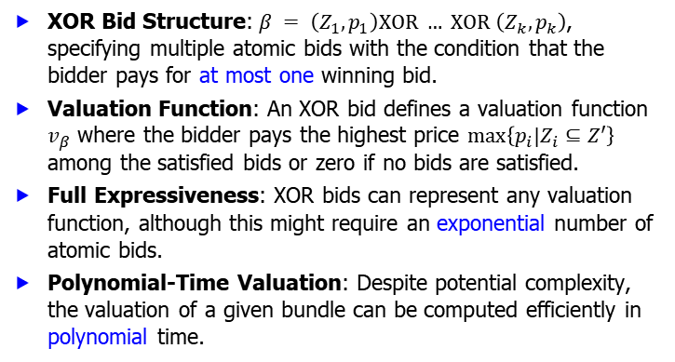
Bidding Languages: XOR Bids
XOR Bid Structure:$β = \left(Z_{1}, p_{1}\right)XOR … XOR \left(Z_{k}, p_{k}\right)$, specifying multiple atomic bids with the condition that the bidder pays for at most one winning bid.
Valuation Function: An XOR bid defines a valuation function $v_{β}$ where the bidder pays the highest price $\max\left\{p_{i}|Z_{i}⊆Z′\right\}$ among the satisfied bids or zero if no bids are satisfied.
Full Expressiveness: XOR bids can represent any valuation function, although this might require an exponential number of atomic bids.
Polynomial-Time Valuation: Despite potential complexity, the valuation of a given bundle can be computed efficiently in polynomial time.
10/14/2024
FIT5226-S2-2024
33/46
Notes:
This slide introduces XOR bids as a more expressive bidding language. It explains how XOR bids work, their ability to capture any valuation function, and the computational efficiency of evaluating bundles using XOR bids.
XOR Bid Structure:
An XOR bid is structured as: $β= \left(Z_{1}, p_{1}\right)⊕\left(Z_{2}, p_{2}\right)⊕…⊕\left(Z_{k}, p_{k}\right)$
This structure specifies multiple atomic bids where the bidder can express preferences for several bundles, but can only win one of them.
The condition that only one bid can be satisfied (the exclusive OR, or XOR condition) allows bidders to convey competing preferences without confusion.
Valuation Function:
The XOR bid defines a valuation function $v_{β}$ such that:
$$v_{β}\left(Z^{′}\right)=\left\{\begin{aligned}\max\left\{p_{i}| Z_{i}⊆Z^{′}\right\} if any Z_{i} is satisfied \\ 0 otherwise \end{aligned}\right.$$
This means that the bidder pays the highest price among the satisfied bids if at least one bid is satisfied. If none of the bids is satisfied, the bidder pays nothing.
Full Expressiveness:
XOR bids can represent any arbitrary valuation function by allowing for the expression of mutually exclusive preferences.
Despite this flexibility, representing certain valuation functions may require an exponential number of atomic bids due to the need to express all combinations of preferences.
Polynomial-Time Valuation:
One of the key advantages of XOR bids is that the valuation of a given bundle can be computed efficiently in polynomial time.
This efficiency is crucial for auction implementations, as it allows for quick evaluations of the winning bids without requiring exhaustive search through all possible allocations.
Advantages of XOR Bids:
Enhanced Expressiveness: XOR bids provide a way to express complex preferences among items, particularly when bidders want to choose between several mutually exclusive options.
Reduction of Complexity in Bidder Preferences: By allowing only one bid to win, XOR bids help streamline the decision-making process for bidders and auctioneers.
Use Cases:
XOR bids are particularly useful in scenarios where:
Bidders have competing interests in different bundles but cannot accept multiple items simultaneously.
Auctions involve items that are substitutes for each other, allowing bidders to select their most preferred alternative.
Conclusion:
XOR bids represent a powerful extension to atomic bidding languages, enabling more nuanced expressions of bidder preferences while maintaining computational efficiency. This makes them a valuable tool in combinatorial auction design, enhancing both bidder strategy and auctioneer outcomes.

Slide 34
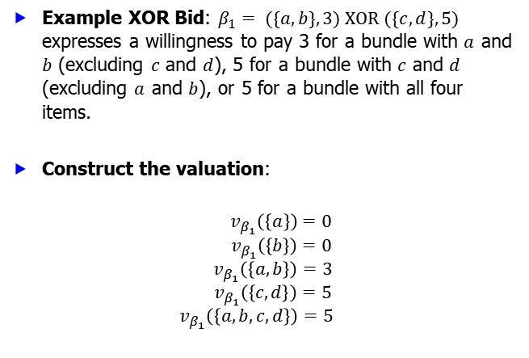
Bidding Languages: XOR Bid Example
Example XOR Bid: $β_{1}= (\{a, b\}, 3) XOR (\{c, d\}, 5)$ expresses a willingness to pay 3 for a bundle with $a$ and $b$ (excluding $c$ and $d$), 5 for a bundle with $c$ and $d$ (excluding $a$ and $b$), or 5 for a bundle with all four items.
Construct the valuation:
$${ v}_{β_{1}}\left(\left\{a\right\}\right)=0$$
$${ v}_{β_{1}}\left(\left\{b\right\}\right)=0$$
$$v_{β_{1}}\left(\left\{a,b\right\}\right)=3$$
$${ v}_{β_{1}}\left(\left\{c,d\right\}\right)=5$$
$$v_{β_{1}}\left(\left\{a,b,c,d\right\}\right)=5$$
10/14/2024
FIT5226-S2-2024
34/46
Notes:
This slide provides a concrete example of an XOR bid, illustrating how it can represent preferences for specific combinations of items and exclusion of others.
XOR Bid Structure: $β_{1}= \left\{\left(a, b\right), 3\right\}⊕\left\{\left(c, d\right), 5\right\}$
This bid expresses a willingness to pay:
$3 for a bundle containing items $a$ and $b$ (excluding $c$ and $d$).
$5 for a bundle containing items $c$ and $d$ (excluding $a$ and $b$).
$5 for a bundle containing all four items $a$, $b$, $c$, and $d$.
Constructing the Valuation Function
The valuation function $v_{β_{1}}$​​ for the XOR bid is defined as follows:
Valuation for Individual Items:
$v_{β_{1}}\left(\left\{a\right\}\right)=0$ : The item $a$ alone does not satisfy any bid.
$v_{β_{1}}\left(\left\{b\right\}\right)=0$ : The item $b$ alone does not satisfy any bid.
Valuation for Bundles of Two Items:
$v_{β_{1}}\left(\left\{a,b\right\}\right)=3$ : The bundle containing both $a$ and $b$ satisfies the first part of the XOR bid, leading to a valuation of $3.
$v_{β_{1}}\left(\left\{c,d\right\}\right)=5$ : The bundle containing both $c$ and $d$ satisfies the second part of the XOR bid, leading to a valuation of $5.
Valuation for the Bundle of All Four Items:
$v_{β_{1}}\left(\left\{a,b,c,d\right\}\right)=5$ : The full bundle of all four items satisfies the second part of the XOR bid (since the second price is higher), resulting in a valuation of $5.
Implications of the Valuation Function:
The valuation function illustrates how bidders can express distinct preferences for combinations of items while adhering to the constraints of the XOR format.
It also demonstrates the flexibility of XOR bids to encapsulate various valuation scenarios and choices available to the bidder, emphasizing the advantage of this bidding language in combinatorial auctions.
Conclusion:
This example highlights the power of XOR bids to represent complex bidding strategies effectively, allowing bidders to articulate their preferences and pay accordingly for the items they value.

Slide 35
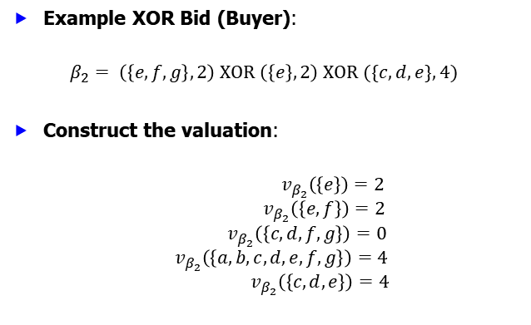

Bidding Languages: XOR Bid Example
Example XOR Bid (Buyer):
$$β_{2}= \left(\left\{e,f,g\right\}, 2\right) XOR \left(\left\{e\right\}, 2\right) XOR (\{c, d,e\}, 4)$$
Construct the valuation:
$${ v}_{β_{2}}\left(\left\{e\right\}\right)=2$$
$${ v}_{β_{2}}\left(\left\{e,f\right\}\right)=2$$
$${ v}_{β_{2}}\left(\left\{c,d,f,g\right\}\right)=0$$
$${ v}_{β_{2}}\left(\left\{a,b,c,d,e,f,g\right\}\right)=4$$
$${ v}_{β_{2}}\left(\left\{c,d,e\right\}\right)=4$$
// $\left\{e\right\}⊆\{e,f\}$
10/14/2024
FIT5226-S2-2024
35/46
Notes:
This slide provides a concrete example of an XOR bid, illustrating how it can represent preferences for specific combinations of items and exclusion of others.
Example XOR Bid
XOR Bid Structure: $β_{2}= \{\left(e, f, g\right), 2\} ⊕\{\left(c, d, e\right), 4\}$
This bid expresses a willingness to pay:
$2 for a bundle containing items $e$, $f$, and $g$ (excluding $c$ and $d$).
$2 for a bundle containing items $e$ (excluding $c$, $d$, $f,$ and $g$)
$4 for a bundle containing items $c$, $d$, and $e$ (excluding $f$ and $g$).
Constructing the Valuation Function
The valuation function $v_{β_{2}}$​​ for the XOR bid is defined as follows:
Valuation for Single Items:
$v_{β_{2}}\left(\left\{e\right\}\right)=2$ : The presence of $e$ satisfies the second part of the XOR bid with a valuation of $2.
Valuation for Bundles of Two Items:
$v_{β_{2}}\left(\left\{e,f\right\}\right)=2$ : The bundle containing $e$ and $f$ also satisfies the second part, as $\left\{e\right\}⊆\{e,f\}$, of the XOR bid, resulting in a valuation of $2.
Valuation for Other Bundles:
$v_{β_{2}}\left(\left\{c, d, f, g\right\}\right)=0$ : This bundle does not satisfy either of the XOR bid conditions, leading to a valuation of $0.
Valuation for the Bundle of All Items:
$v_{β_{2}}\left(\left\{a, b, c, d, e, f, g\right\}\right)=4$ : The full bundle of all items satisfies the last part of the XOR bid (since the price for this bundle is higher), resulting in a valuation of $4.
Valuation for the Bundle of $c$, $d$, and $e$:
$v_{β_{2}}\left(\left\{c, d, e\right\}\right)=4$ : This bundle satisfies the last part of the XOR bid, leading to a valuation of $4.
Implications of the Valuation Function:
The valuation function illustrates how bidders can express distinct preferences for various combinations of items while adhering to the constraints of the XOR format.
It emphasizes the flexibility of XOR bids in capturing complex valuation scenarios, allowing bidders to articulate their preferences and pay accordingly for the items they value most.
Conclusion:
This example highlights the effectiveness of XOR bids in combinatorial auctions, enabling bidders to represent a wider range of preferences and ensure that they only pay for the highest-valued satisfied bundle.

Slide 36
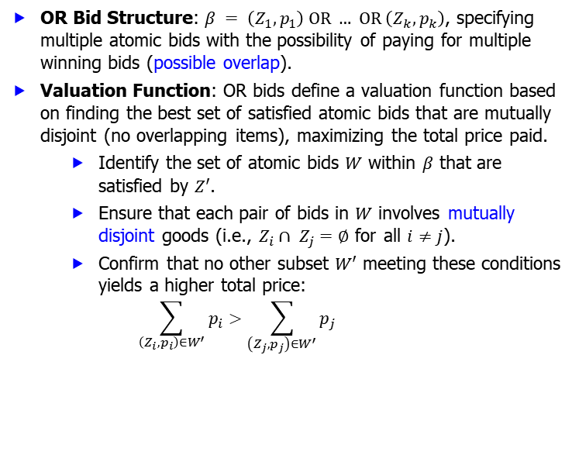
Bidding Languages: OR Bids
OR Bid Structure: $β = \left(Z_{1}, p_{1}\right) OR … OR \left(Z_{k}, p_{k}\right)$, specifying multiple atomic bids with the possibility of paying for multiple winning bids (possible overlap).
Valuation Function: OR bids define a valuation function based on finding the best set of satisfied atomic bids that are mutually disjoint (no overlapping items), maximizing the total price paid.
Identify the set of atomic bids $W$ within $β$ that are satisfied by $Z′$.
Ensure that each pair of bids in $W$ involves mutually disjoint goods (i.e., $Z_{i}∩ Z_{j}=∅$ for all $i≠j$).
Confirm that no other subset $W′$ meeting these conditions yields a higher total price: $\sum_{\left(Z_{i},p_{i}\right)∈W^{′}}{p_{i}}>\sum_{\left(Z_{j},p_{j}\right)∈W^{′}}{p_{j}}$
10/14/2024
FIT5226-S2-2024
36/46
Notes:
This slide introduces OR bids, which allow bidders to potentially win and pay for multiple atomic bids within a single OR bid. It explains how the valuation function is determined by selecting the best set of non-overlapping satisfied bids.
OR Bid Structure
Definition: $β = \left(Z_{1}, p_{1}\right)OR … OR \left(Z_{k}, p_{k}\right)$
An OR bid consists of multiple atomic bids, where bidders express their willingness to pay for any of the specified bundles $Z_{i​}$ at price $p_{i}$​.
Valuation Function
Valuation Logic:
The valuation function for an OR bid is based on identifying a set of atomic bids $W$ within $β$ that are satisfied by a given bundle $Z^{’}$.
The objective is to maximize the total price paid by selecting atomic bids that do not overlap (mutually disjoint goods).
Steps to Construct the Valuation Function
Identify the Set of Atomic Bids:
Determine the set of atomic bids $W$ within $β$ that are satisfied by the given bundle $Z′$.
Each atomic bid $\left(Z_{i}, p_{i}\right)$ is satisfied if $Z_{i}⊆Z^{′}$.
Ensure Mutually Disjoint Goods:
Confirm that each pair of bids in $W$ consists of mutually disjoint goods: $Z_{i}∩Z_{j}=∅$for all $i ≠j.$
This ensures that the same item is not allocated to multiple bids in the selected set.
Maximize Total Price:
Confirm that no other subset $W’$ of bids, which satisfies the conditions above, yields a higher total price: $\sum_{\left(Z_{i},p_{i}\right)∈W^{′}}{p_{i}}>\sum_{\left(Z_{j},p_{j}\right)∈W^{′}}{p_{j}}$
This guarantees that $W$ is the optimal set of bids that maximizes the total price paid.
Example of OR Bid Valuation
Let’s illustrate with an example:
OR Bid Example:
$$β=\left(A,10\right) OR \left(B,15\right) OR \left(C,20\right)$$
Satisfying Bundle: Suppose we have a bundle:
$$Z^{′}=\left\{A,B\right\}$$
Determine Satisfied Bids:
$\left(A,10\right)\left(A, 10\right)\left(A,10\right)$is satisfied (price = $10).
$\left(B,15\right)\left(B, 15\right)\left(B,15\right)$is satisfied (price = $15).
$\left(C,20\right)\left(C, 20\right)\left(C,20\right)$is not satisfied.
Check for Disjoint Goods:
$\left(A,10\right)\left(A, 10\right)\left(A,10\right)$ and $\left(B,15\right)\left(B, 15\right)\left(B,15\right)$ have disjoint goods, hence included in $W$.
Total Price Calculation:
Total price for selected bids: $Total Price=10+15=25$
Confirm Optimality:
If another subset $W^{′}$ only satisfied $\left(B,15\right)\left(B, 15\right)\left(B,15\right)$: $\sum_{\left(Z_{j}, p_{j}\right)∈W′}{p_{j}=15} (which is less than 25)$
Thus, the selected set $W$ maximizes the total price paid.
Conclusion
OR bids allow bidders to express preferences across multiple atomic bids, enabling them to pay for several bundles as long as their goods are disjoint.
This structure enhances flexibility in bidding, allowing for more complex preferences while ensuring that bidders can maximize their overall value based on the items they win.

Slide 37
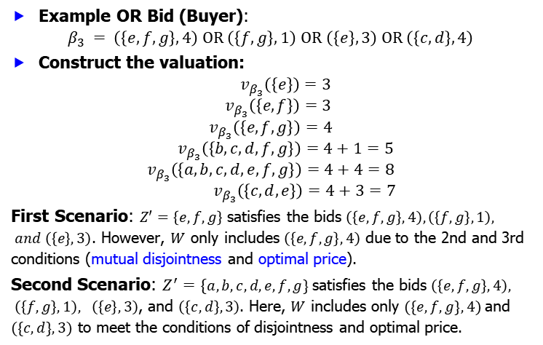
Bidding Languages: OR Bid Example
Example OR Bid (Buyer):
$$β_{3} = \left(\left\{e,f,g\right\}, 4\right) OR \left(\left\{f, g\right\}, 1\right) OR \left(\left\{e\right\},3\right) OR \left(\left\{c,d\right\}, 4\right)$$
Construct the valuation:
$${ v}_{β_{3}}\left(\left\{e\right\}\right)=3$$
$${ v}_{β_{3}}\left(\left\{e,f\right\}\right)=3$$
$$v_{β_{3}}\left(\left\{e,f,g\right\}\right)=4$$
$${ v}_{β_{3}}\left(\left\{b,c,d,f,g\right\}\right)=4+1=5$$
$$v_{β_{3}}\left(\left\{a,b,c,d,e,f,g\right\}\right)=4+4=8$$
$${ v}_{β_{3}}\left(\left\{c,d,e\right\}\right)=4+3=7$$
First Scenario: $Z′=\left\{e,f,g\right\}$ satisfies the bids $\left(\left\{e,f,g\right\},4\right), \left(\left\{f,g\right\},1\right), and \left(\left\{e\right\},3\right)$. However, $W$ only includes $\left(\left\{e,f,g\right\},4\right)$ due to the 2nd and 3rd conditions (mutual disjointness and optimal price).
Second Scenario: $Z^{′}=\{a,b,c,d,e,f,g\}$satisfies the bids $\left(\left\{e,f,g\right\},4\right), \left(\left\{f,g\right\},1\right), \left(\left\{e\right\},3\right)$, and $\left(\left\{c,d\right\},3\right)$. Here, $W$ includes only $(\{e,f,g\},4)$and $(\{c,d\},3)$ to meet the conditions of disjointness and optimal price.
10/14/2024
FIT5226-S2-2024
37/46
Notes:
This slide provides an example of an OR bid, highlighting the bidder's willingness to pay for different combinations of items and the additive nature of the prices for multiple satisfied bids.
OR Bid Definition:
Example OR Bid:
$$β_{3}= \left(\left\{e,f,g\right\}, 4\right)OR \left(\left\{f, g\right\}, 1\right)OR \left(\left\{e\right\}, 3\right)OR \left(\left\{c,d\right\}, 4\right)$$
Valuation Construction for $β₃$
Valuation Function
The valuation function ${v_{β}}_{3}(Z′)$assigns values based on the bundle $Z′$being evaluated against the specified bids in $β₃$.
Valuation Results
${v_{β}}_{3}\left(\left\{e\right\}\right)= 3$: Satisfied by bid $(e, 3).$
${v_{β}}_{3}\left(\left\{e,f\right\}\right)= 3 :$ Satisfied by bid $(e, 3),$since f does not contribute to a higher value.
${v_{β}}_{3}\left(\left\{e,f,g\right\}\right)= 4 :$ Satisfied by bid $(e,f,g, 4).$
${v_{β}}_{3}\left(\left\{b,c,d,f,g\right\}\right)= 4 + 1 = 5 :$ Satisfied by both bids $(e,f,g, 4)$and $(f,g, 1) (totaling 5),$but they cannot be chosen together due to mutual disjointness.
${v_{β}}_{3}\left(\left\{a,b,c,d,e,f,g\right\}\right)= 4 + 4 = 8$: Satisfied by bids $\left(e,f,g, 4\right)$ and $(c,d, 4).$
${v_{β}}_{3}\left(\left\{c,d,e\right\}\right)= 4 + 3 = 7 :$ Satisfied by bids $(c,d, 4)$and $(e, 3).$
Scenarios to Analyze
First Scenario
Bundle: $Z′ = \{e,f,g\}$
Satisfied Bids:
$(e,f,g, 4)$
$(f,g, 1)$
$(e, 3)$
Selected Set W: Only includes $(e,f,g, 4)$due to the conditions of mutual disjointness and optimal price.
Second Scenario
Bundle: $Z = \left\{a,b,c,d,e,f,g\right\}$
Satisfied Bids:
$(e,f,g, 4)$
$(f,g, 1)$
$(e, 3)$
$(c,d, 4)$
Selected Set W: Includes $(e,f,g, 4)$and $(c,d, 4)$to meet the conditions of disjointness and maximize total price.
Summary of Key Points
OR Bids provide flexibility by allowing multiple bids, with the option to pay for any combination of non-overlapping bundles.
The valuation function considers all satisfied bids but ensures selections are mutually disjoint to maximize total price.
Different scenarios highlight how bundles can be satisfied by various bids while adhering to the rules governing OR bids.
Conclusion
Understanding how to construct valuations from OR bids enables bidders to better strategize their bids and maximize their value across multiple options, reflecting a more complex preference structure.

Slide 38
Bidding Languages: OR Bid Limitations
Reduced Expressiveness: OR bids are less expressive than XOR bids; certain valuation functions cannot be represented using OR bids.
Computational Complexity: Determining the valuation of a bundle given an OR bid is NP-hard, meaning it can be computationally challenging for large problem instances.
10/14/2024
FIT5226-S2-2024
38/46
Notes:
This slide discusses the limitations of OR bids compared to XOR bids, noting that OR bids cannot capture all possible valuation functions and that evaluating bundles using OR bids can be computationally difficult.
Reduced Expressiveness:
OR bids are less expressive than XOR bids; certain valuation functions cannot be represented using OR bids.
This limitation means that complex preferences, which can be captured through XOR bids, might be lost when using OR bids.
Computational Complexity:
Determining the valuation of a bundle given an OR bid is NP-hard.
This complexity implies that as the number of items and bids increases, the computational effort required to evaluate valuations may grow exponentially, making it challenging for large problem instances.

Slide 39
Winner Determination: Computational Challenges and Approaches
NP-Hardness: Finding the winner in combinatorial auctions is NP-hard, indicating the problem's inherent computational complexity.
Practical Solutions:
Integer Linear Programming: Encoding the problem as an integer linear program and using solvers, which often provide solutions in reasonable time despite the theoretical NP-hardness.
Efficient Algorithms: Several algorithms exist that perform well in many cases.
Approximate Algorithms: Exploring solutions with bounded approximation guarantees.
Heuristic Solutions: Employing greedy algorithms that iteratively select the best bid to satisfy.
10/14/2024
FIT5226-S2-2024
39/46
Notes:
This slide reiterates the computational challenges of winner determination and outlines various approaches used in practice. It emphasizes the use of integer programming, efficient algorithms, approximation techniques, and heuristic methods to address the NP-hardness.
NP-Hardness:
Finding the winner in combinatorial auctions is NP-hard, indicating the problem's inherent computational complexity. This means that no known polynomial-time algorithms can guarantee an optimal solution for all instances of the problem.
Practical Solutions:
Integer Linear Programming: The problem can be encoded as an integer linear program. Using solvers for this formulation often yields solutions in reasonable time frames, despite the theoretical NP-hardness of the problem.
Efficient Algorithms: Various algorithms have been developed that perform well under many scenarios, effectively navigating the complexities of the problem.
Approximate Algorithms: These algorithms explore solutions that come with bounded approximation guarantees, ensuring that the solution is close to optimal within a specified range.
Heuristic Solutions: Greedy algorithms can be employed to iteratively select the best bid to satisfy, providing a practical approach to finding satisfactory solutions even if they are not optimal.

Slide 40
VCG Mechanism: Achieving Truthful Valuations
Motivation: Existing auction types are susceptible to strategic manipulation, making it difficult to ensure agents reveal their true valuations (i.e., underbid or overbid).
VCG Mechanism: A generalization of the Vickrey auction that incentivizes truthful bidding in combinatorial settings.
Incentive Compatibility: Telling the truth becomes a dominant strategy for all agents.
VCG (Vickrey-Clarke-Groves)
10/14/2024
FIT5226-S2-2024
40/46
Notes:
This slide transitions to the VCG mechanism, highlighting its ability to address the problem of strategic bidding and incentivize truthful revelation of valuations.
Motivation:
Many existing auction types are susceptible to strategic manipulation by participants, which complicates the process of ensuring that agents reveal their true valuations of the goods being auctioned.
VCG Mechanism:
The VCG (Vickrey-Clarke-Groves) mechanism is a generalization of the Vickrey auction tailored for combinatorial settings. It is designed to incentivize truthful bidding by ensuring that agents' payments are based on the externalities they impose on others.
Incentive Compatibility:
In the VCG mechanism, revealing true valuations becomes a dominant strategy for all agents. This means that each agent maximizes their utility by reporting their actual valuations rather than trying to manipulate the outcome through strategic bidding.

Slide 41
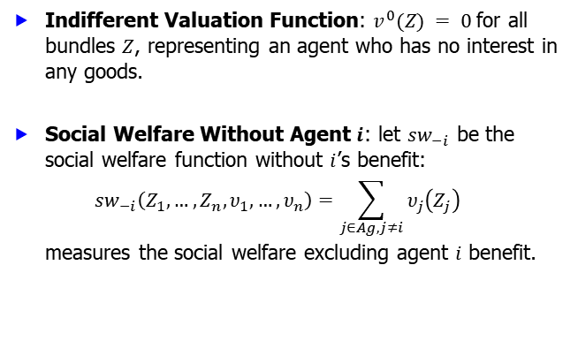
VCG Mechanism: Notation
Indifferent Valuation Function: $v^{0}(Z) = 0$for all bundles $Z$, representing an agent who has no interest in any goods.
Social Welfare Without Agent $i$: let $sw_{−i}$ be the social welfare function without $i$’s benefit:
$$sw_{−i}\left(Z_{1}, …, Z_{n},υ_{1},…,υ_{n}\right)=\sum_{j∈Ag, j≠i}{υ_{j}\left(Z_{j}\right)}$$
measures the social welfare excluding agent $i$ benefit.
10/14/2024
FIT5226-S2-2024
41/46
Notes:
This slide introduces notation for the VCG mechanism, defining the indifferent valuation function and the social welfare function that excludes a specific agent's contribution.
Indifferent Valuation Function:
The indifferent valuation function is denoted as $v^{0}(Z) = 0$for all bundles $Z$. This represents an agent who has no interest or valuation for any of the goods available in the auction.
Social Welfare Without Agent $i$:
The social welfare function without the benefit of agent $i$ is denoted as $sw_{−i}\left(Z_{1}, …, Z_{n},υ_{1},…,υ_{n}\right)=\sum_{j∈Ag, j≠i}{υ_{j}\left(Z_{j}\right)}$
This function measures the total social welfare by summing the valuations of all agents except for agent iii. It effectively captures the collective benefit derived from the allocation of goods to all agents other than iii.

Slide 42
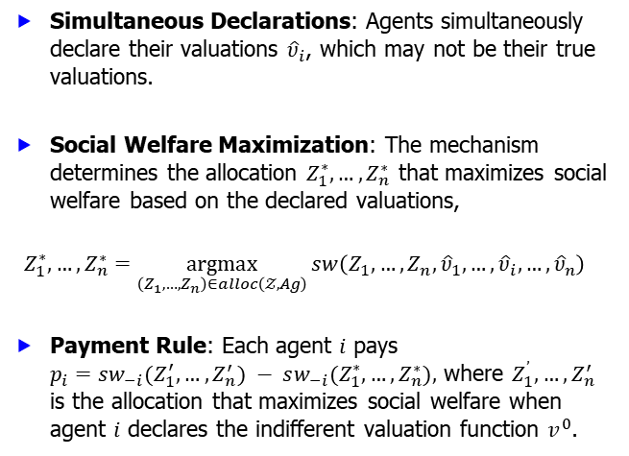
VCG Mechanism: How it Works
Simultaneous Declarations: Agents simultaneously declare their valuations ${\hat{\text{υ}}}_{i}$, which may not be their true valuations.
Social Welfare Maximization: The mechanism determines the allocation $Z_{1}^{∗}, …, Z_{n}^{∗}$ that maximizes social welfare based on the declared valuations,
$$Z_{1}^{∗}, …, Z_{n}^{∗}=\underset{\left(Z_{1}, …, Z_{n}\right)∈alloc\left(𝒵, Ag\right)}{argmax}{sw\left(Z_{1}, …, Z_{n},{\hat{υ}}_{1},…,{\hat{υ}}_{i}, …,{\hat{υ}}_{n}\right)}$$
Payment Rule: Each agent $i$ pays $p_{i}=sw_{−i}(Z_{1}^{′}, …, Z_{n}^{′}) − sw_{−i}(Z_{1}^{∗}, …, Z_{n}^{∗}),$ where $Z_{1}^{’}, …, Z_{n}^{′}$ is the allocation that maximizes social welfare when agent $i$ declares the indifferent valuation function $v^{0}$.
10/14/2024
FIT5226-S2-2024
42/46
Notes:
This slide describes the step-by-step functioning of the VCG mechanism, including the simultaneous declaration of valuations, the optimization process, and the payment rule that incentivizes truthful bidding.
Simultaneous Declarations:
Agents simultaneously declare their valuations, denoted as ${\hat{\text{υ}}}_{i}$​, which may not necessarily reflect their true valuations for the items available in the auction.
Social Welfare Maximization:
The VCG mechanism seeks to determine the allocation $Z_{1}^{∗}, …, Z_{n}^{∗}$ that maximizes overall social welfare based on the declared valuations. This is expressed mathematically as: $Z_{1}^{∗}, …, Z_{n}^{∗}=\underset{\left(Z_{1}, …, Z_{n}\right)∈alloc\left(𝒵, Ag\right)}{argmax}{sw\left(Z_{1}, …, Z_{n},{\hat{υ}}_{1},…,{\hat{υ}}_{i}, …,{\hat{υ}}_{n}\right)}$
Here, $alloc\left(𝒵, Ag\right)$ represents the set of all possible allocations of the items to agents, and $sw$ is the social welfare function that sums up the valuations of all agents for the allocated bundles.
Payment Rule:
Each agent $i$ is required to pay an amount based on the social welfare derived from the allocations. The payment for agent $i$ is calculated as follows: $p_{i}=sw_{−1}(Z_{1}^{′}, …, Z_{n}^{′},{\hat{υ}}_{1},…,υ^{0}, …,{\hat{υ}}_{n}) − sw_{−i}(Z_{1}^{∗}, …, Z_{n}^{∗},{\hat{υ}}_{1},…,{\hat{υ}}_{i}, …,{\hat{υ}}_{n})$
In this equation, $Z_{1}^{′}, …, Z_{n}^{′}$ represents the allocation that would maximize social welfare if agent $i$ declared the indifferent valuation function $v^{0}$(which yields zero valuation for all bundles). The payment reflects the difference in social welfare caused by agent $i$'s participation, incentivizing agents to report their true valuations. $Z_{1}^{′},…, Z_{n}^{′}=\underset{\left(Z_{1}, …, Z_{n}\right)∈alloc\left(𝒵, Ag\right)}{argmax}{sw\left(Z_{1}, …, Z_{n},{\hat{υ}}_{1},…,υ^{0},…,{\hat{υ}}_{n}\right)}$

Slide 43
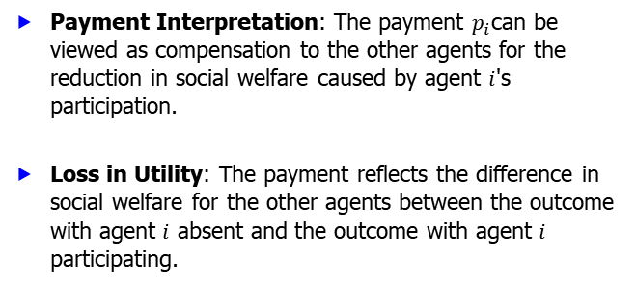
VCG Mechanism: Compensation Principle
Payment Interpretation: The payment $p_{i}$can be viewed as compensation to the other agents for the reduction in social welfare caused by agent $i$'s participation.
Loss in Utility: The payment reflects the difference in social welfare for the other agents between the outcome with agent $i$ absent and the outcome with agent $i$ participating.
10/14/2024
FIT5226-S2-2024
43/46
Notes:
This slide clarifies the rationale behind the VCG payment rule, emphasizing its role as compensation for the impact of an agent's participation on the overall social welfare.
Payment Interpretation:
The payment $p_{i}$​ made by agent $i$ can be understood as a form of compensation to the other agents in the auction. This compensation is necessary due to the change in social welfare that results from the inclusion of agent $i$ in the auction process.
Loss in Utility:
The payment is specifically designed to reflect the loss in utility experienced by the other agents because of agent $i$'s participation. More formally, it accounts for the difference in social welfare between two scenarios:
Without Agent $i$: The social welfare when agent $i$ is absent, denoted as $sw_{−i}(Z_{1}^{′}, …, Z_{n}^{′})$.
With Agent iii: The social welfare with agent iii present, denoted as $sw_{−i}\left(Z_{1}^{∗}, …, Z_{n}^{∗}\right)$.
Therefore, the payment made by agent $i$ serves to ensure that the overall impact of their participation does not unfairly disadvantage other agents. It is structured to maintain fairness in the auction, encouraging truthful bidding while also reflecting the true social cost of including agent $i$ in the outcome.

Slide 44
VCG Mechanism: Truthful Bidding as a Dominant Strategy
Key Result: The VCG mechanism ensures that no agent can benefit by declaring anything other than their true valuation.
Single Good Example: In an auction for a single good, the agent with the highest valuation pays the second-highest valuation, effectively compensating the others for their loss in not winning.
10/14/2024
FIT5226-S2-2024
44/46
Notes:
This slide highlights the central achievement of the VCG mechanism: making truthful bidding a dominant strategy. It provides a simplified example with a single good to illustrate how the payment rule aligns incentives with truthful revelation.
Key Result:
The VCG mechanism guarantees that truthful bidding is the dominant strategy for all agents involved. This means that each agent maximizes their utility by reporting their true valuation of the goods, as any deviation from this strategy would not yield a better outcome.
Single Good Example:
Consider an auction for a single good among multiple agents. In this scenario:
The agent with the highest valuation wins the auction and is awarded the good.
The price paid by the winning agent is equivalent to the second-highest valuation among the other agents. This structure ensures that:
The winning agent compensates the losing agents for their loss in not securing the good, which aligns with the principle of maximizing social welfare.
Each agent is incentivized to reveal their true valuation, as bidding higher or lower would either not change their chances of winning or could result in them paying more than they would otherwise.
This feature of the VCG mechanism is crucial for maintaining fairness and encouraging honest participation in auctions, ultimately leading to efficient allocations based on true valuations.

Slide 45
VCG Mechanism: Achieving Social Welfare Maximization
Dominant Strategy: Truthful bidding is the best strategy for all agents, regardless of others' actions.
Social Welfare Guarantee: The VCG mechanism guarantees that the allocation selected maximizes social welfare based on the true valuations.
10/14/2024
FIT5226-S2-2024
45/46
Notes:
This slide concludes by emphasizing that the VCG mechanism effectively addresses the challenges of strategic manipulation in combinatorial auctions. It guarantees both truthful bidding and the attainment of maximum social welfare.
Dominant Strategy:
The VCG mechanism ensures that truthful bidding is the optimal strategy for all agents, independent of the actions taken by other agents. This characteristic means that each agent maximizes their own utility by accurately reporting their valuation of the goods, leading to outcomes that reflect true preferences.
Social Welfare Guarantee:
One of the key strengths of the VCG mechanism is its ability to guarantee that the allocation produced maximizes social welfare based on the true valuations submitted by agents. This means that:
The mechanism selects the allocation that results in the highest total utility for all participants, thus achieving an efficient outcome.
The VCG mechanism effectively aligns individual incentives with overall societal welfare, as each agent’s truthful declaration directly influences the allocation decision that maximizes collective benefit.
Overall, the VCG mechanism facilitates a framework where agents are encouraged to act honestly, thereby enhancing the efficiency and fairness of the auction process while ensuring that the overall social welfare is optimized.

Slide 46
Resources
This lecture includes materials adapted from:
○
"Multiagent Systems" by Michael Woolridge (Wiley, 2009).
Course materials designed by Terry Payne, University of Liverpool.
Artwork published under Creative Commons by http://pixabay.com.
10/14/2024
FIT5226-S2-2024
46/46

